Slide 1
Graphical sensitivity
MSci331—Week 4-5

Slide 2
Range of Optimality
maximize 12A + 10B
s.t. 8A + 6B ≤ 48 (1)
5A + 10B ≤ 50 (2)
A ≥ 1 (3)
A ≤ 5 (4)
A,B ≥ 0

Slide 3
Range of Feasibility
maximize 12A + 10B
s.t. 8A + 6B ≤ 48 (1)
5A + 10B ≤ 50 (2)
A ≥ 1 (3)
A ≤ 5 (4)
A,B ≥ 0

Slide 4
Range of Feasibility
maximize 12A + 10B
s.t. 8A + 6B ≤ 48 (1)
5A + 10B ≤ 50 (2)
A ≥ 1 (3)
A ≤ 5 (4)
A,B ≥ 0

Slide 5
Range of Feasibility
maximize 12A + 10B
s.t. 8A + 6B ≤ 48 (1)
5A + 10B ≤ 50 (2)
A ≥ 1 (3)
A ≤ 5 (4)
A,B ≥ 0

Slide 6
Range of Feasibility
maximize 12A + 10B
s.t. 8A + 6B ≤ 48 (1)
5A + 10B ≤ 50 (2)
A ≥ 1 (3)
A ≤ 5 (4)
A,B ≥ 0

Slide 7
Range of Feasibility
maximize 12A + 10B
s.t. 8A + 6B ≤ 48 (1)
5A + 10B ≤ 50 (2)
A ≥ 1 (3)
A ≤ 5 (4)
A,B ≥ 0

Slide 8
Range of Feasibility
maximize 12A + 10B
s.t. 8A + 6B ≤ 48 (1)
5A + 10B ≤ 50 (2)
A ≥ 1 (3)
A ≤ 5 (4)
A,B ≥ 0

Slide 9
Computer Sensitivity Analysis
maximize 12A + 10B
s.t. 8A + 6B ≤ 48 (1)
5A + 10B ≤ 50 (2)
A ≥ 1 (3)
A ≤ 5 (4)
A,B ≥ 0
Dual prices
1 for each constraint
Ranges of Optimality
1 for each variable
Ranges of feasibility
1 for each constraint

Slide 10
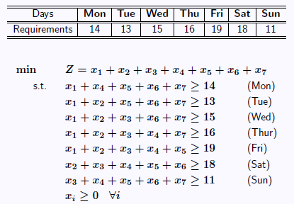
Computer Sensitivity Analysis

Slide 11
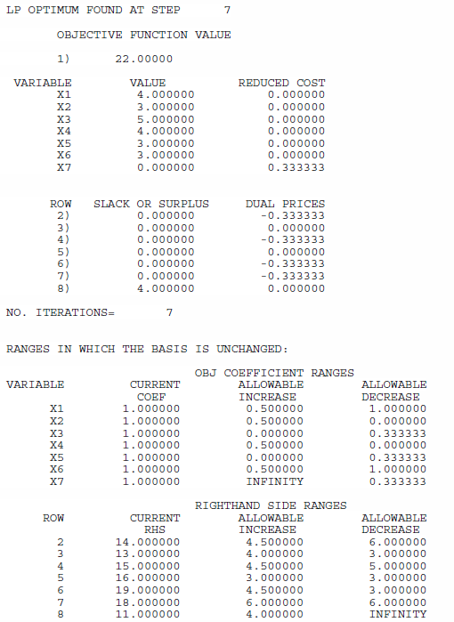
Computer Sensitivity Analysis

