Slide 1
Active Directory Structure
June 2011
Erick Engelke

Slide 2
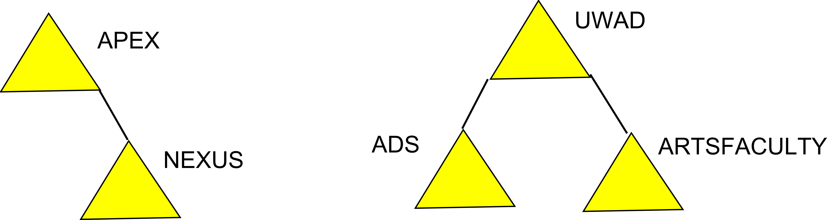
Starting Point

Slide 3
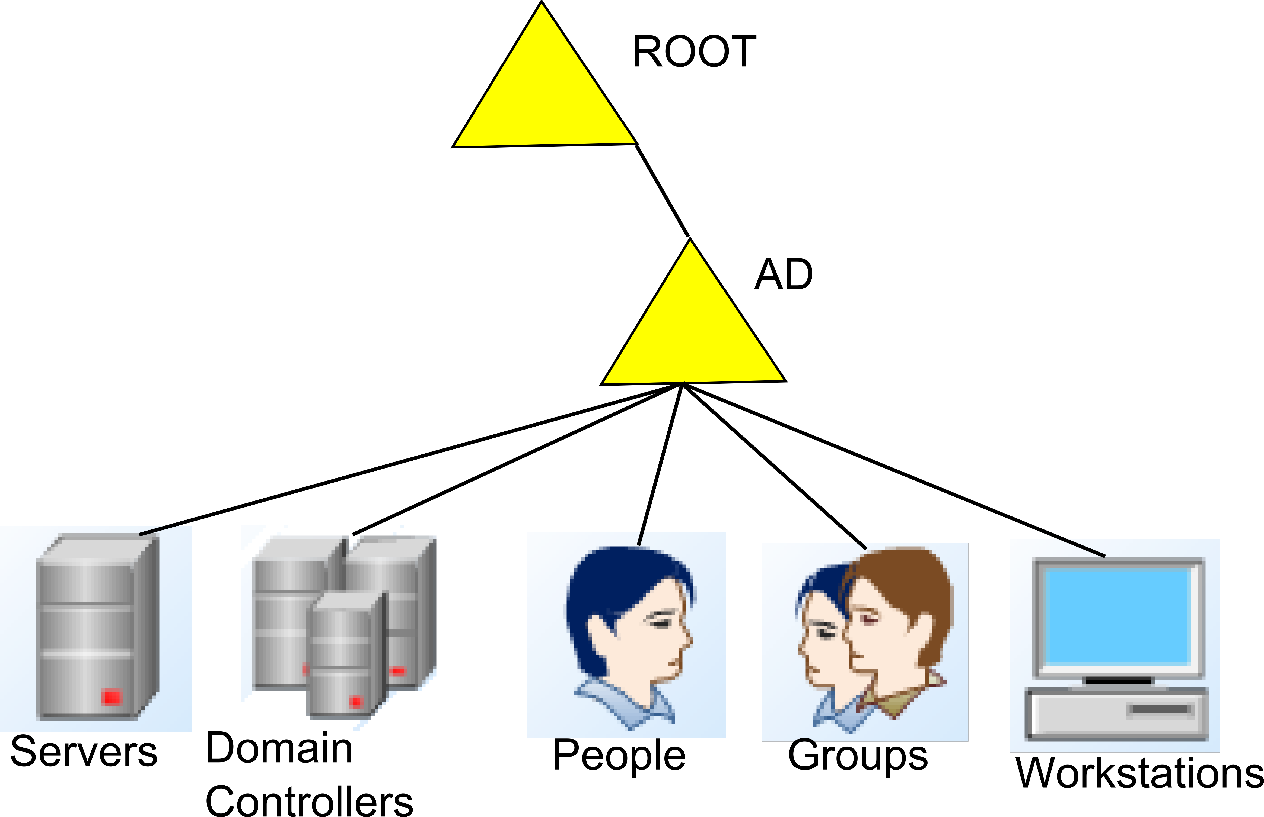
Top Level Structure

Slide 4
People Organization

Slide 5
People
Administered primarily by WatIAM
Second account for elevated privileges (!)
Optional second or third account for lesser privileges (_)
Use of smartcards for some people
Like passport – personal userids cannot be shared
Use other mechanisms to share data
Userid/password equivalent to a signature (pki coming)
Generic accounts can have more than one person – eg. helpdesk, askawarrior, WatIAm will treat these differently

Slide 6
Below Each Unit
Users – WatIAm managed
Hidden – WatIAm managed, not public
Support - !erick, _erick and mssql service accounts
Generic – WatIAm managed, roles
Legacy – accounts from the old ADs which haven’t been worked out yet

Slide 7
Administration OU
Alumni
Authentication only – auth, but don’t allow logins
Corporate – contractors
Guests – wireless access, logins too
Non-UW – permanent people not staff
Orphaned
Support – privileged, harder passwords

Slide 8
Groups Organization

Slide 9
Groups
Very useful for managing access to data
WatIAM will manage some groups
  isaFaculty, isaStaff, isaStudent lists
  Course lists
  Departmental lists
  These lists define who is ACTIVE
Delegated access to groups OU

Slide 10
WatIAm Dept Groups
Auto management of department lists
  Drupal – lists of staff
  Sharepoint – departmental sites
  Labs – who can use special software
  Servers – who can access data
  Podiums ?
Eg. Erick is in both IST and EngComp now

Slide 11
Naming Conventions
Groups, servers, print queues need names
A list of prefixes is in the document
  sju_ – St. Jeromes University
  math_ - math
  env_ - environment
  uw_ - campus, eg. UCIST
  IdM_ - ID management system… WatIAm

Slide 12
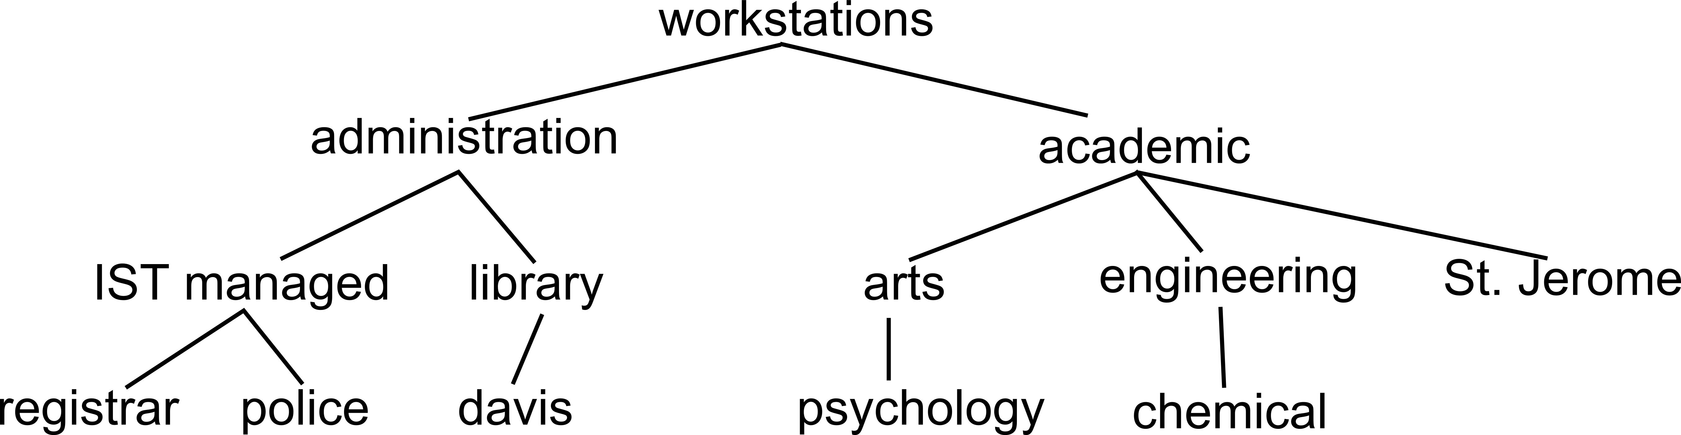
Workstations Organization

Slide 13
Workstations
subtree follows organization of university workstation management
IST manages many administration PCs
Library and residences have own IT shops
Much software purchased and policies set at faculty level
Non-windows machines also in the tree

Slide 14
Summary
Domain should be as simple as possible while reflecting the structure of UW
Future services like video conferencing and digital signing will make use of AD
Economize effort, minimize duplication
Take the best of ADS and Nexus

Slide 15
Next Steps
Create a test AD with the new structure, make sure WatIAm doesn’t hiccup
Implement the new AD structure in ADS, Nexus and WatIAM
Migrate accounts from ADS to Nexus (this is a non-destructive copy, then account exist in both domains)
  For existing nexus users, just copy the ADS SID into Nexus SidHistory field
  For non-Nexus users, copy the whole account over, including password (new SID, but old SidHistory)
  Do group migrations too
Get WatIAM creating/managing accounts in both domains
At this point, all the users are moved. Document everything, then we can start thinking about servers and workstations

Slide 16
Following Steps
Migrate SharePoint server
Begin migrating workstations
Migrate workgroup servers
Migrate databases systems
Migrate wireless
Migrate UWace

Slide 17
Timetable
March 2011 – discovery stage
April 2011 – begin design documentation
May 2011 – begin tests of migration tools
July 2011 – begin migrating real accounts
Sept. 2011 – March 2012
  Workstations, servers, databases, etc.

Slide 18
The End
Thank you.

