Slide 1
Ubuntu Linux on Chorus Workstations
Engineering Computing
April 2018

Slide 2
Need
Supporting embedded boards sometimes requires Linux dev environment
  E&CE 150 course requires Linux in a few weeks
  Some upper year programs need Linux apps too
  Do not want to spend money on additional hardware or support FTEs
Students want some Unix/Linux training before workterms
  Both course related and EngSoc training
Bring Your Own Computer (BYOC) often wastes instructor and class time configuring systems

Slide 3
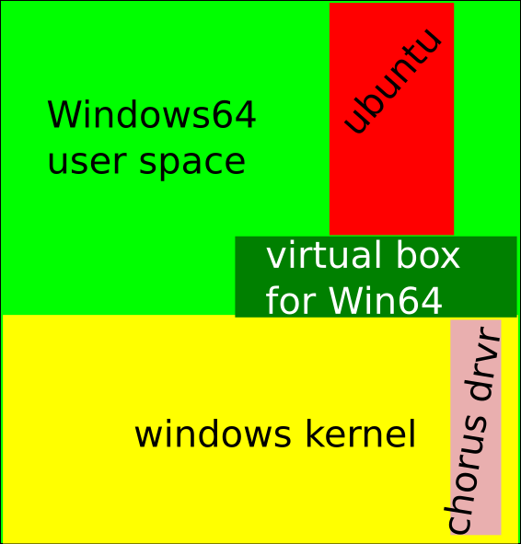
Virtualization
Virtual Box allows Linux as a user process on any equipped Chorus Windows station
  Full Linux 64 bit, multi-core OS
We had to write a Windows driver to support full user space access with no Administrative privileges
NAT for TCP/IP access – security enforced
  cannot run a network server

Slide 4
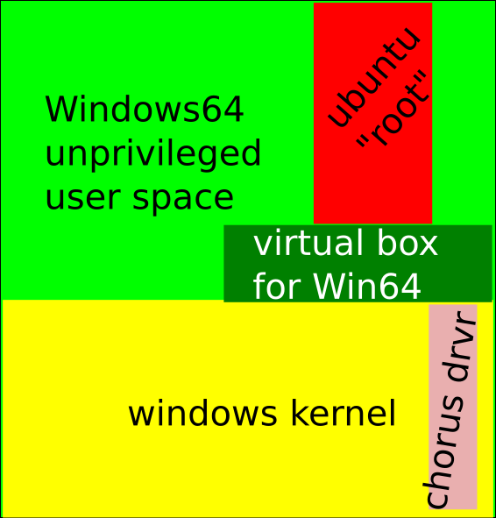
Full Experience
Student can be root user in a padded cell
Can fully customize the environment
Padded cell prevents students from interfering with future users

Slide 5
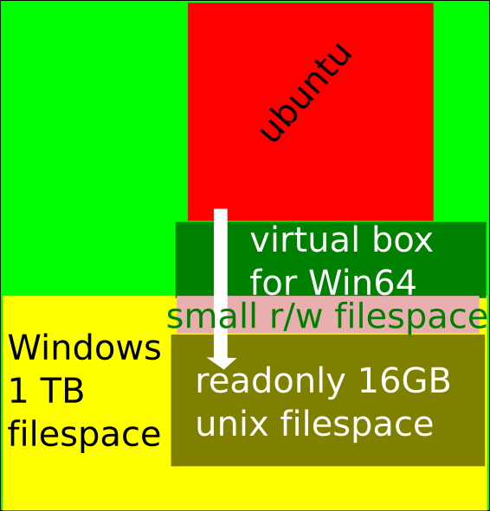
Virtualized Disk
Linux OS and file space is totally virtualized
16 GB readonly image union a small filesystem, growable by another 16GB.
User customations start as a 70kB changelog to the base image

Slide 6
Home Directory
Home directory is mostly used as scratch space
  Eg. Object and binary files after compilation
A separate ./home subdirectory points to shared chorus/nexus N: drive
  Students can permanently and safely store data on N:
Applications in Linux and Windows can share data through the N: drive

Slide 7
User Experience
Shared clipboard (cut/paste in either Windows or Linux)
Shared home subdirectory on Nexus/Chorus server
Full privileges on a 64 bit linux system with support for multiprocessing
Documentation web page
  http://www.eng.uwaterloo.ca/~erick/ubuntu.html (latest updates)

