Slide 1
engAdvisor
Erick Engelke
Engineering Computing
Faculty of Engineering
Erick@uwaterloo.CA

Slide 2
Primary Goal
Provide advisors time-sensitive information about students before they fall far behind

Slide 3
Strategy
Allow instructors’ near real-time course marks to be made available to advisors
Allow easy import of the Instructor marking data (currently spreadsheets)
Sort data by entry date – shows labs, tests, cdts, midterms and exams in sequence
Given a student (ID number or a tap with Watcard), display current term course stats
Maintain notes about each student’s housing, family home, extracurricular activities, etc.
Secure system to just advisors and Associate Dean
Future options for data mining
Supports Cell Phone / Tablet access through responsive design

Slide 4
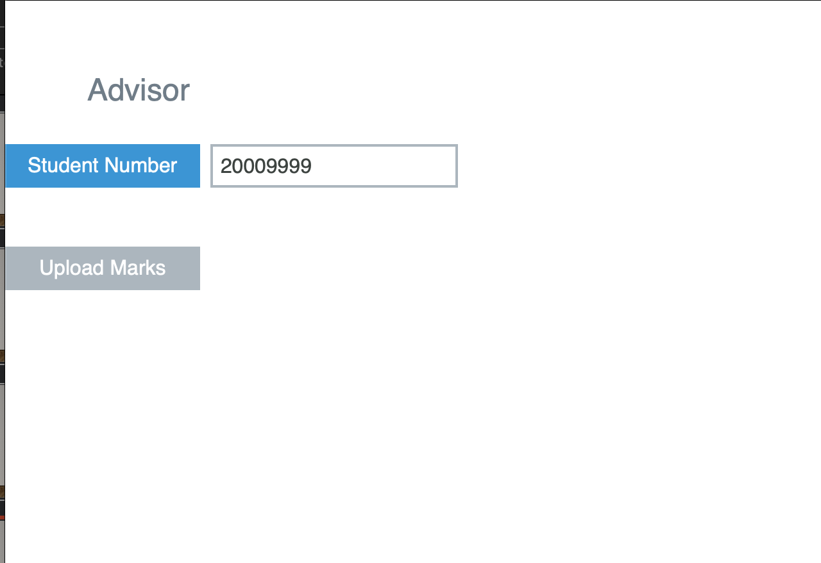
Clean User Interface
Main Menu
Current options are to
view a student’s record
or upload marks for a course.
Supports Watcard readers to automatically bring up the appropriate student record.

Slide 5
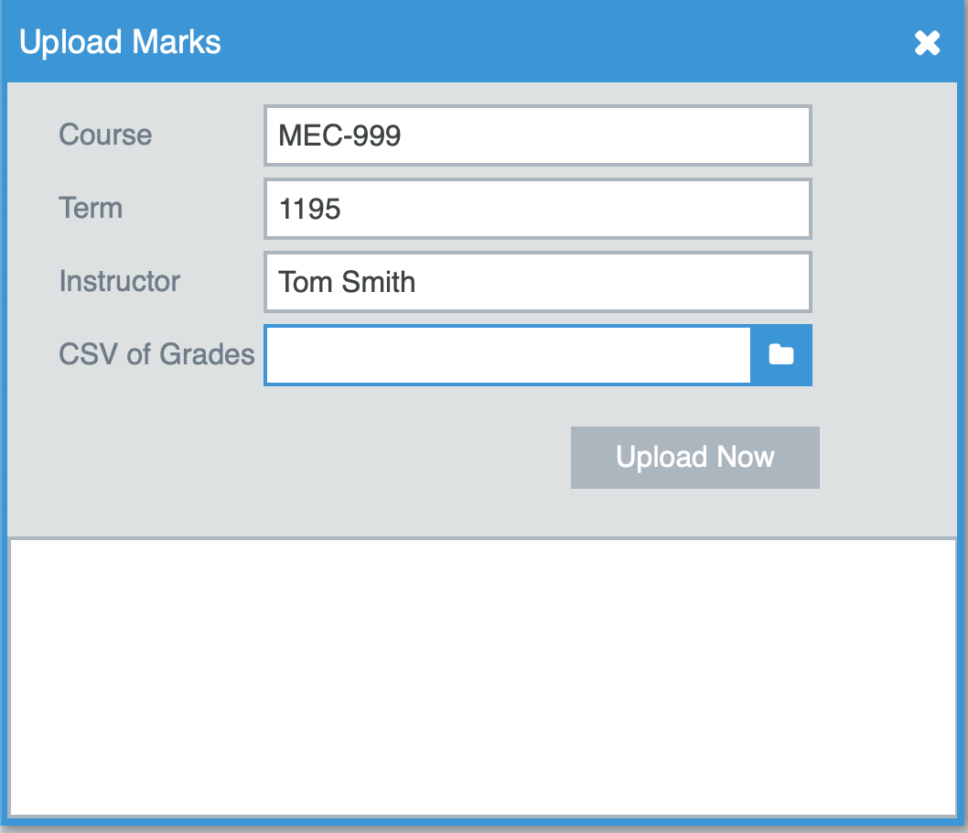
Add Marks CSV File
Enter a few facts then upload the CSV file

Slide 6
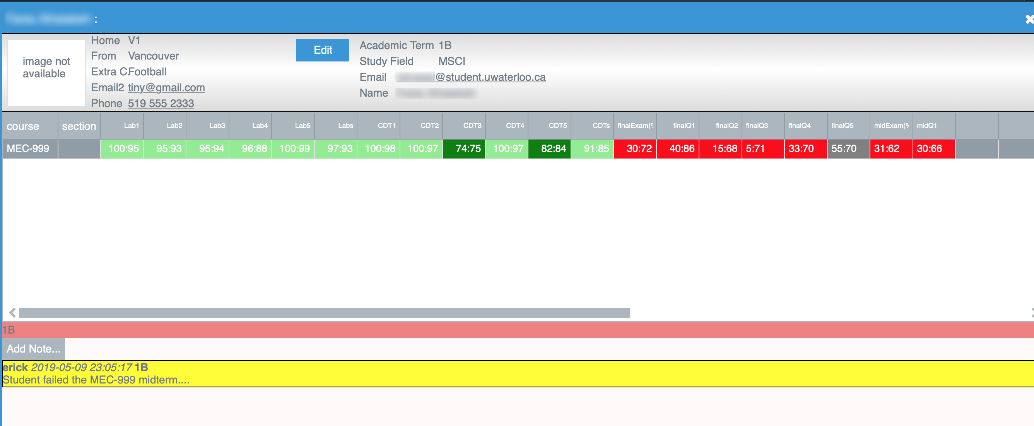
Student Marks
- Student Mark : Class Average
- Supports Advisor notes for future reference
- Links to Email program
- Color coding shows percentages at a glance

Slide 7
Few Assumptions
Spreadsheets have students in rows starting with student number,
Spreadsheets have use numeric grades in column (non-numeric data columns ignored)
Spreadsheets uploaded weekly (roughly) to reflect assignments, labs, midterms,…

Slide 8
Considerations
System may be enhanced as needed
Open to suggestions to better meet advisor needs
OAT integration will add photos and past course marks

