Slide 1
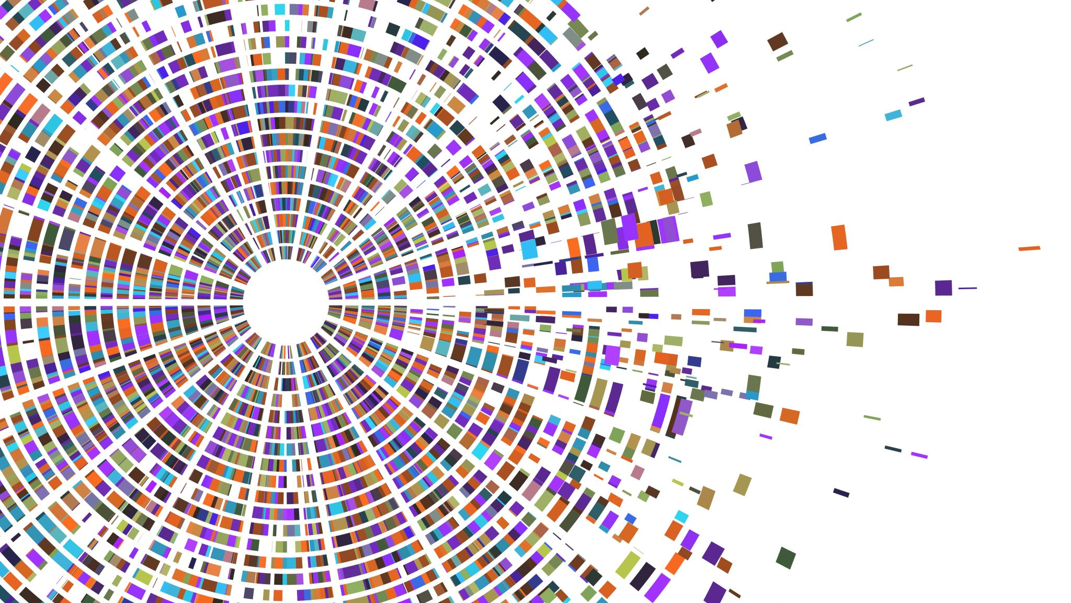
Online Profile Builder
Engineering Computing
Presentation: August 2023

Slide 2

Goals
Easy to use tool to create consistent pre-approved, formatted web pages for faculty members in the WCMS
Allow self-service for those who choose to do it themselves
Allow for departmental or faculty-wide reps to edit faculty’s pages
Optionally use SCOPUS to populate a list of ‘current’ papers
Uses registrar data to populate courses taught
Support for accessibility needs

Slide 3

Sample page:
https://pilots.uwaterloo.ca/engineering-computing/profile/erick
Uptake:
Used by 597 faculty pages effective August 2023
- (Science + Engineering)

Slide 4
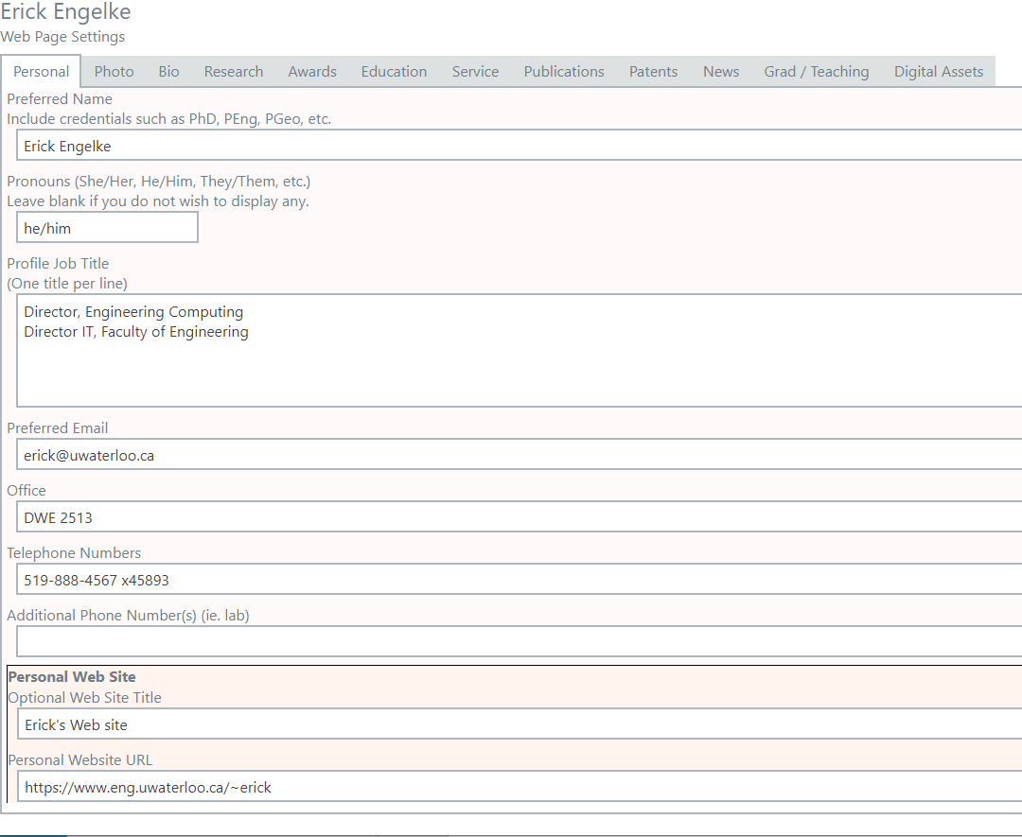
Easy to use – self service
Allows faculty to curate their own pages within the guidelines
Fields are ordered in OPB identically to their online display in WCMS – ease of finding things
Spell checking and Grammarly enabled fields
While many faculty elect to write their own, many others offload to department/faculty-level communications staff
  Supports various methods of delegation
    Department
    Faculty-level
    Individual delegation to any other staff member (for four months)

Slide 5
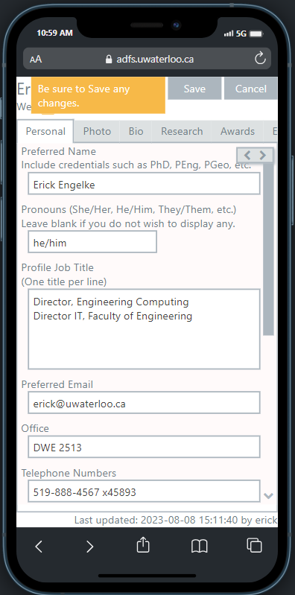
Additional Features
Cell phone compatible – responsive design
ARIA – accessibility enabled
ADFS logins
Research can be auto-populated from SCOPUS database
Records and displays last date of update and by whom – used to determine which records may be stale and in need of a refresh!
Some fields allow embedded http/https references (e.g. papers)
  Supports direct URLs or markdown URLs

Slide 6
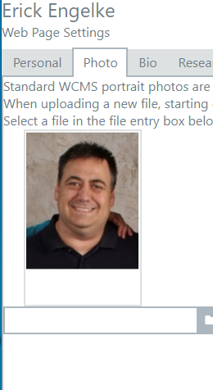
More features
Photo uploading and resizing
Simple instructions and some feedback – e.g.
  write biography in third person
  dimensions of picture specified, and cropping displayed at design time
  “accepting Grad students” is a simple flag, leads to UW admission URL
Fields left blank are not displayed (e.g. patents, etc)
Automatic placement of all data at the recommended location for user profiles as agreed upon by communications staff

Slide 7

Observations
Consistency in a distributed environment is often more achievable though automation like OPB
Replaced a Web 1.0 application (OFIS) with Web 2.0 (OnlineProfileBuilder)
  Users appreciate attractive and easier-to-use applications
WCMS integration is challenging, we need a better way of integrating future apps without needing individual WCMS modules for each
  Leverage the data and talent in other groups with a defined interface
  Minimize number of rewrites every time WCMS goes through upgrades

