Slide 1
iTOP @ UW
BEGINNINGS
(internal draft. April 13, 2015)
Presentation by Erick Engelke
Engineering Computing

Slide 2
If you want something you’ve never had,
You’ve got to do something you’ve never done
An asset management system is more than a piece of software or a service, it forces you to
collect information you did not collect before
change processes to accommodate the system
impose organization where none existed before

Slide 3
Overview
iTOP is Open Source ITIL implementation
Includes Asset Management
Used by thousands of organizations
Optional addition supports IPAM (both IPv4, IPv6)
Object Oriented DB and Platform implementation, extensibile

Slide 4
View by OrgUnit
iTOP designed for multiple customers supported by themselves, and by one admin company
Allows ‘Arts’+’Renison’ view, ‘Engineering’ view, Master view, etc.
Dashboard, queries, updates, etc. All limited by current departmental view, or UW-wide view. Eg. Show me new systems (last 30 days) in AHS.

Slide 5
Out of the box…
Does generic Asset Management – entered by humans (YUCK)
Has a reasonable user interface, and supports CSV/Excel imports/exports
Typical server platforms (MySQL, Apache, PHP Unix/Windows) (eg. LAMP), LDAP for authentication
Entire user experience is Web based, works on most browsers
Only known problem is finicky IE on WServer2008 in secure mode… just use any other browser
Scalable – tested @UW with 400,000 computers, over 1,000,000 assets, running on 16 MB desktop PC as a server

Slide 6
We added… attributes
Want custom attributes, eg. UW-PurchaseOrder to describe PO#
  Extended base asset object to include UW-PurchaseOrder field
  Add a module that handles verification/sanity check of new field
  Extended XML configs to display UW-PurchaseOrder
That’s it. Now you can display, search on, etc.

Slide 7
We added… integration
No built-in integration with WatIAm, ONA, etc.
iTOP does not have an Asset Gathering feature, but we have two: EC’s AUDIT, and IST’s MS SCCM
We integrated iTOP with AUDIT, SCCM*, ONA, WATIAM
Nightly and some hourly updates
*SCCM integration is not completed at this time

Slide 8
Challenges
Courses to use iTop available, approx $2k, we did not pursue
iTop could use more technical documentation, but it suffices
Did not have native IPv6 support (simple 3rd party download)
ONA did not have IPv6 support (Bruce added it)
Not all the information required is currently known/recorded, such as
  who owns which devices
  MAC addresses of all switch ports
User training – GUI software, IT people and use suggests video based training initially

Slide 9
Newton’s Method
Take a stab, refine direction, repeat
The system will not be all-knowing on day one
No one person knows all the information required. We will improve with input from others
Issues, such as ownership of devices may be an approximation using ONA field ownership or other automated sources (well, it’s known for Nexus devices)
Issues such as PO #’s, date installed are not automated and may never be found/entered for older equipment.
Epoch – we should start adding new data for new devices, going forward

Slide 10
The Various Assets to Manage

Slide 11
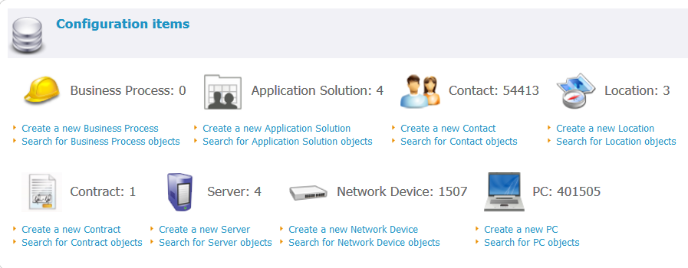
Dashboard (may personalize)

Slide 12
Interesting Stock Features
Display dimensions are responsive design, and supports ctrl +/-
Network dependency maps – eg. Switch impacts, device depends…
Output to CSV, Excel from any list
Bulk imports in CSV, Excel, XML, and native. We used native for auto-adds because we are importing so much information we need high speed
Reporting features – mini SQL queries on dashboard
Support for VMs, Hypervisors, RAID arrays, PDUs, etc. We will not auto-populate these on initial release

Slide 13
Automation
What works today / Still to do
IPv4, IPv6, DNS device entries for whole campus (ONA).
Maintainers / Owners of those devices possible to extract from ONA permissions or InfoBlox fields… not interpreted yet – biggest challenge at this point
PC and Mac workstation data from Audit, SCCM, including software
Switches and Routers for all of campus from ONA (~2500)
Network connections from switches/routers/devices
UWdir, used to reference users, admins, etc. Organizational units done by Nexus People OUs.
Still need to complete a security audit

Slide 14
What Has Engineering Done
Extended the SQL database Schema to add new fields
Extended the XML page descriptions to show new fields
Added the 3rd party IPv6 solution
Written about 1,000 lines of PHP for automated integration with existing systems
Integrated with Audit, SCCM and Ona
Written a Mac application collection agent
Has not made any code changes to the stock code, updates will be easy
Enlisted help of ISS for security audit

Slide 15
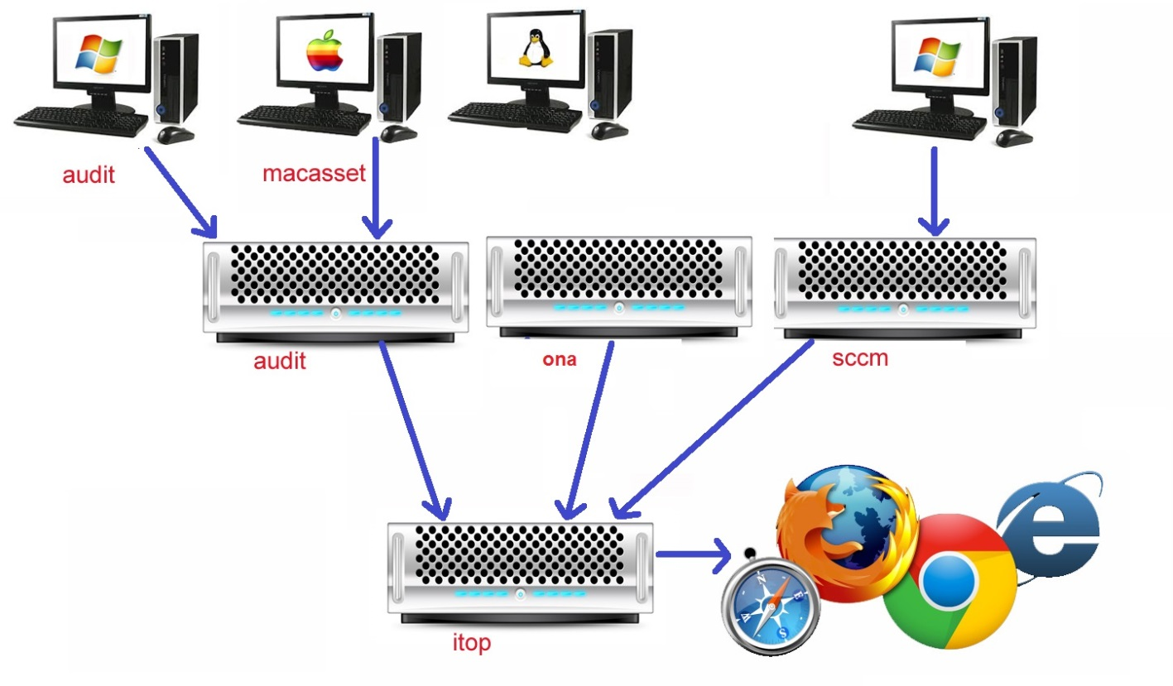
Big Picture – How Data Is Collected

Slide 16
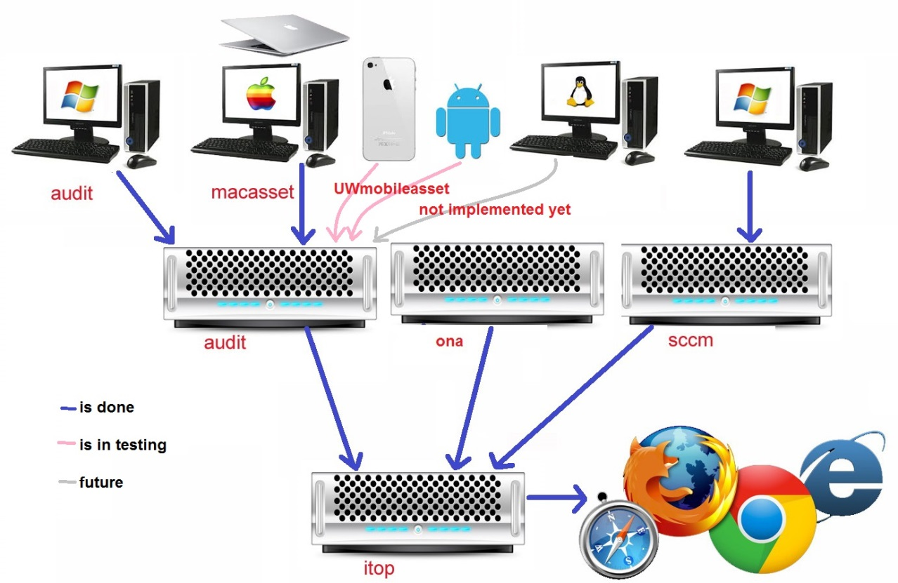
Likely Next Development Steps***

Slide 17
Timeline
Plan is a production system
  based on a combination of requested features, iTop functionality, etc.
  priority given to mac and pc clients, which is the unwieldy part
  available by end of April 2015, incl. all the automation described
    Six months after notified of choice of EngComp solution
    Implementation co-existent with normal duties of staff
  for Engineering and other faculties who wish to use it soon
  to integrate with other campus plans TBD
    does interest exist
    Spec, partners and management TBD
    Future timelines, Steering committee? TBD

Slide 18
Who we are
Engineering Computing
  Erick Engelke – Architect
  Ray White – iTop assistance, Infrastructure
  Daniel Delattre – Engineering Computing – Audit
IST
  Bruce Campbell – IST - ONA
  John Mayall – IST – SCCM Expert
  Pat Matlock – IST – Security Expert
  Kresimir Renic - IST – Planning

