Slide 1

Student Blocks 2.0
Engineering Computing
Erick Engelke
April 2024

Slide 2
Goals
Manage the student block assignments for roughly 8,000 undergraduate students
Improve the efficiency of Advisors with ever-increasing student counts and special needs
Standardize data – such as dropdowns rather than relying on mere textual notes
    Useful going forward for collecting statistics
Improve process for changing workforce dynamics (people rotate in/out often)
Synergy with other systems coming online

Slide 3
Synergies
One of our goals is to move away from reams of spreadsheets, where data is siloed, less organized and less useful
OAT (Math/CS)
    Program review coming in a few years
  Engineering Course Management System (tentative name)
  Engineering Accreditations System
  These systems share purposes and will increasingly share data
  These systems will supplant some institutional sources which have various barriers and where bad data is sometimes not corrected

Slide 4
SBO 2.0 Functionality – Advisor’s Perspective
Store Course Blocks and associated courses/sections
Store Student Blocks to Course Blocks mappings and Group capacity limits
Help organize students into Student Blocks
    Display vital stats about each student, such as MNP, failed courses, etc.
    Organize information like: reduced loads, reason for and time of delayed re-entry, notes, ….
    Allow one to move a student to a different course blocks, and noting the fullness capacity of each Student Block.
Store minimum/maxmimum course loads for each program / year
Alert advisors of students dropping or adding courses, and resulting overloads / underloads
Produce course block and student block CSV files for upload to Quest

Slide 5
Why can’t we just use spreadsheets
The faculty is under increasing pressure due to growth, accreditation, and other stressors
Spreadsheets are usually inconsistently designed, and so it is difficult for planners and the accreditation team to extract meta data from numerous spreadsheets
The Registrar is decreasing some services, meaning former institutional sources for data are going away
As we saw with Oat/ASIS, bringing order and exchangeable data means we can leverage the data in new and helpful ways
Also, spreadsheets are a nightmare for security. They can be lost or leaked on thumb drives, ransomware, drive crashes, human error, etc. And data will be lost over time.

Slide 6
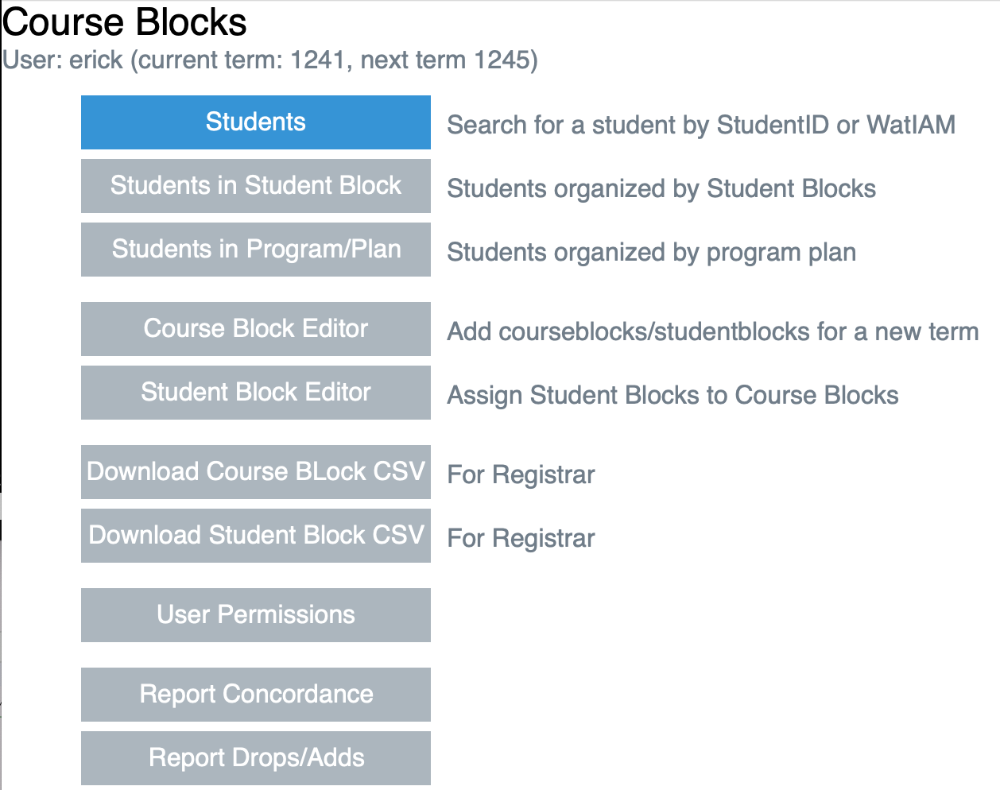
User Interface
Simple to navigate

Slide 7
System Organization
Lists of Students for Inspection and Changing Student Blocks or Other Information
    Searchable by Student ID # or Watiam userid – to deal with a specific student
    Program / Year Term view showing all students – can drill down to individual students
    Also a Student Block view, showing all students in the SB. Can drill down to individual students
  Daily List of Course Additions / Deletions
    Displays student and their changes, also any overload/underload conditions
  Configuration Data
    Course Blocks, Student Blocks, Overload/Underload data
    Userid management

Slide 8
New Features since last meeting
SBO keeps track of the class size, useful for balancing loads across multiple student blocks.
    Displays a soft target limit advisor’s set – and current capacity anytime you would be moving students around
SBO displays more summary statistics about students, eg. MNP, etc. needed to properly assign progress
Identifies students who appear to have left the program

Slide 9
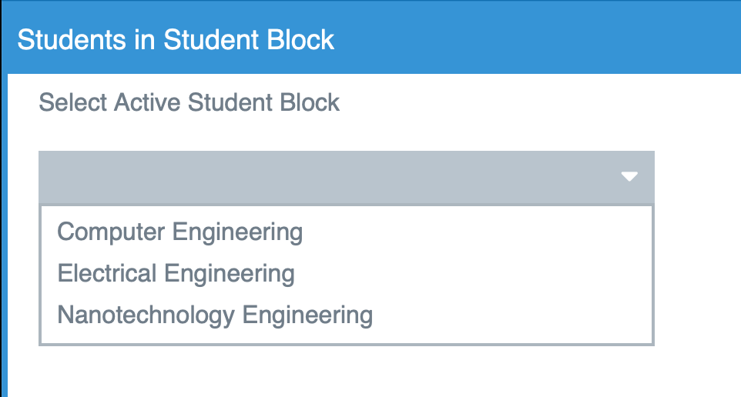
Many Menus are Context-Sensitive
Eg. Advisor for Nano, ELE and COMPE sees only those programs

Slide 10
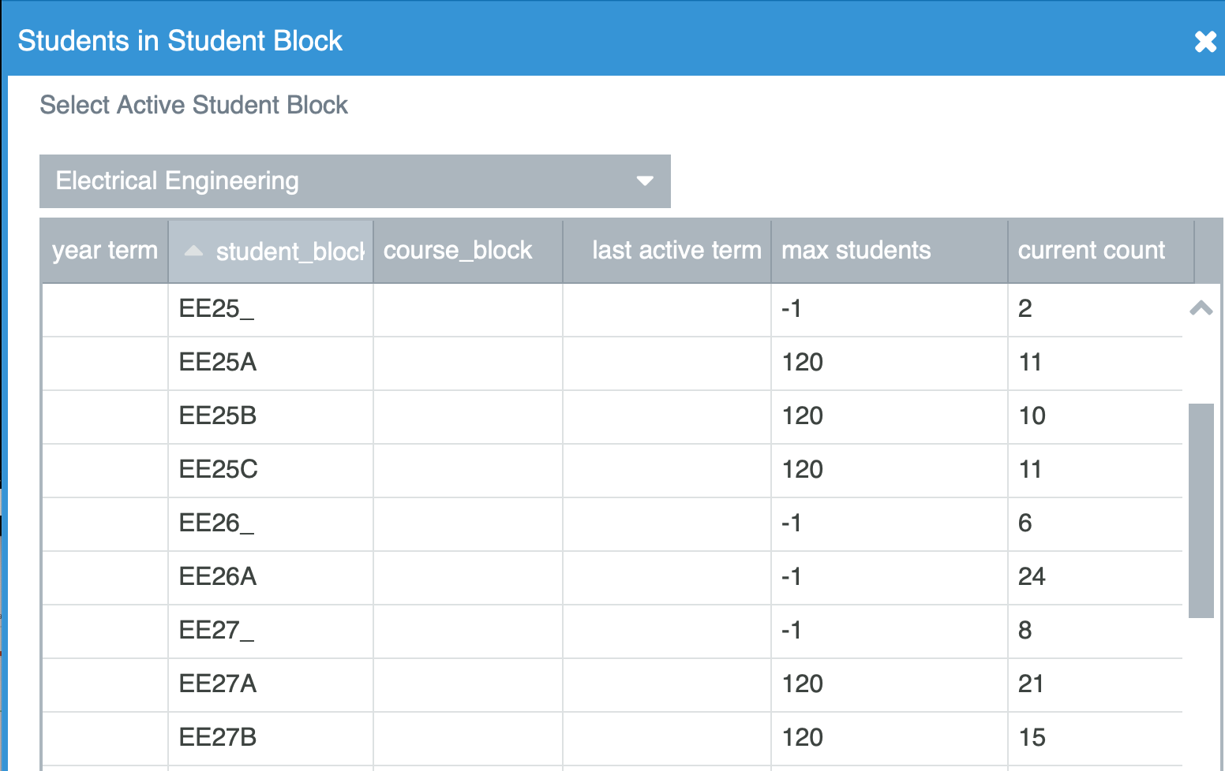
Summary Information.
Eg. Student Block capacity / maximums
Here -1 is undefined,
And 120 was limit

Slide 11
Options when viewing a Student
Several screens show lists of students within a Class or Student Block, or students who have add/dropped courses
One can easily drill down to the individual student
    Look at course marks from Oat and Registrar flags
    Change Student Block
    Set information about reduced loads, term absences, delay to future term (specify which term), note reasons for absence (exchange students, etc.)
    View or add notes
    Email the student with one button
    Copy the WatIAm userid or student number by clicking

Slide 12
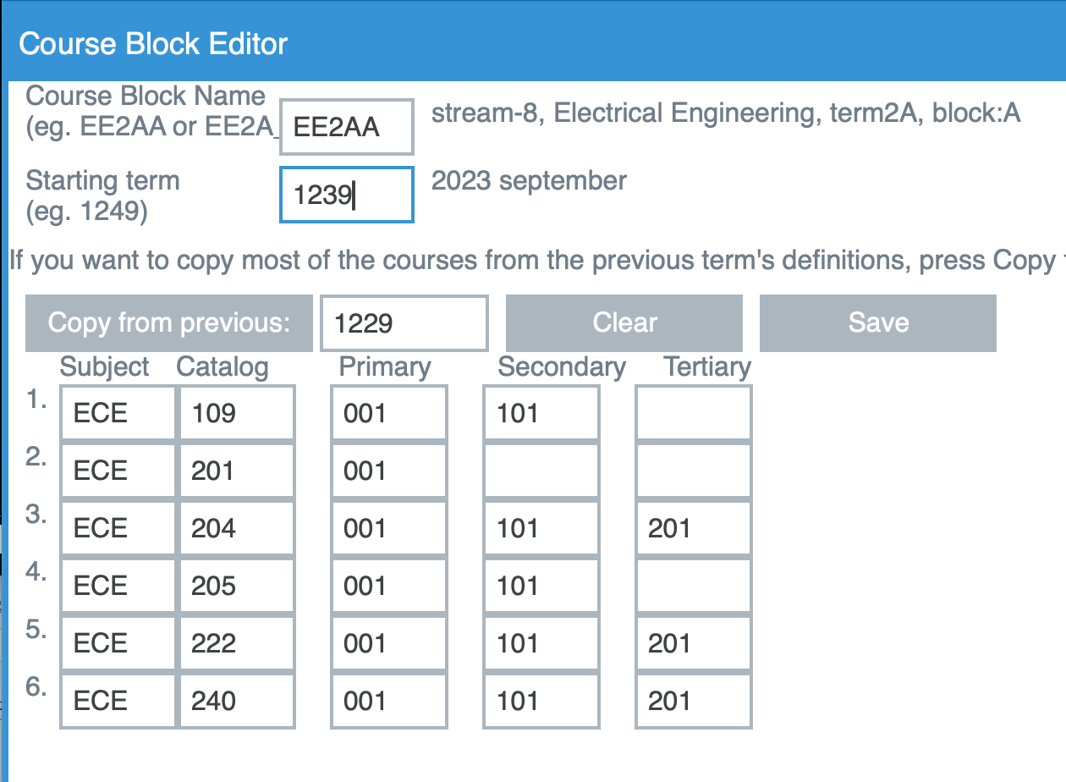
When possible – automation is used to reduce input effort
Eg. Copy most courses
from previous year, then
Edit any changes.
Several fields have
Human-readable
Comments for
added ease and
error detection
(eg. date, course block)

Slide 13
Outputs
System generates CSV files (similar to former SBO 1.x)
    Course Blocks, listing courses and sections
    Student Blocks listing students
  These are downloaded to the Advisor’s workstation and can be uploaded to Quest

