Slide 1
SYDE 575: Image Processing
Introduction
Read Textbook Chapters 1 & 2

Slide 2
What is Digital Image Processing?
Definition: manipulation of digital image for enhancement, compression, transmission, information extraction or analysis
  “manipulation” involves denoising, enhancement, registration, color mapping, rescaling, feature point detection, illumination reduction, …
Digital image defined as a 2-d function: f(x,y)
‘x’ and ‘y’ are spatial (in-plane) coordinates
f(x,y) is the value (usually stored as discrete) at a spatial (x,y) location
With multiple images of the same scene, one can deduce 3-d geometry and pixels in the image could have 3-d coordinates e.g., f(x,y,z) where (x,y,z) represents spatial coordinates
A video is defined as a 3-d function: f(x,y,t) where ‘t’ represents time

Slide 3
Computer Vision
Image Processing
Image Analysis
Image Understanding
Scene
Information
Image Analysis: content extraction e.g., segmentation, shape description, boundary detection, mathematical morphology, texture feature extraction, motion estimation
Image Understanding: decision making based on content extraction; covered in SD372 and SD675
SD575 deals primarily with “Image Processing” and, later in the course, “Image Analysis”
Notes:
Can give an example wrt operational facial recognition.

Slide 4
Why is image processing difficult?
Mapping from a 3-d world to a 2-d plane
Measured intensity is a function of many factors
Interpreting groups of pixels as interesting objects is easy for the human, but not for the computer
Loads of data to process!
Local windows versus global interpretation

Slide 5
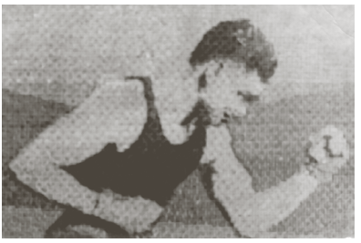
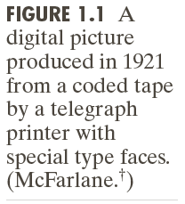
Early Image Processing
Newspapers needed to send pictures across the Atlantic Ocean quickly
Source: Gonzalez and Woods

Slide 6
Early Image Processing
Capturing and transmitting images from space
Source: Gonzalez and Woods

Slide 7
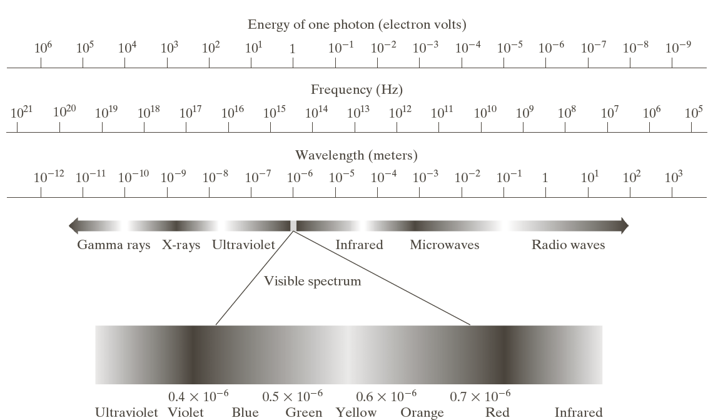
Electromagnetic Spectrum
Source: Gonzalez and Woods

Slide 8
Machine Vision
Source: Gonzalez and Woods

Slide 9
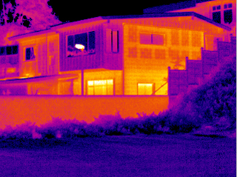
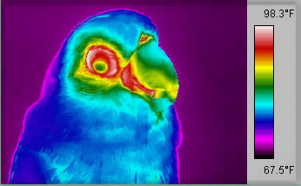
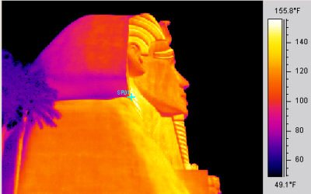
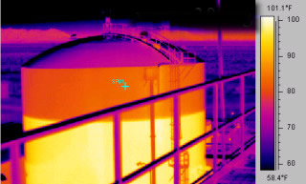
Thermal (Infrared) Imaging
http://www.nationalinfrared.com/image_browser.php

Slide 10
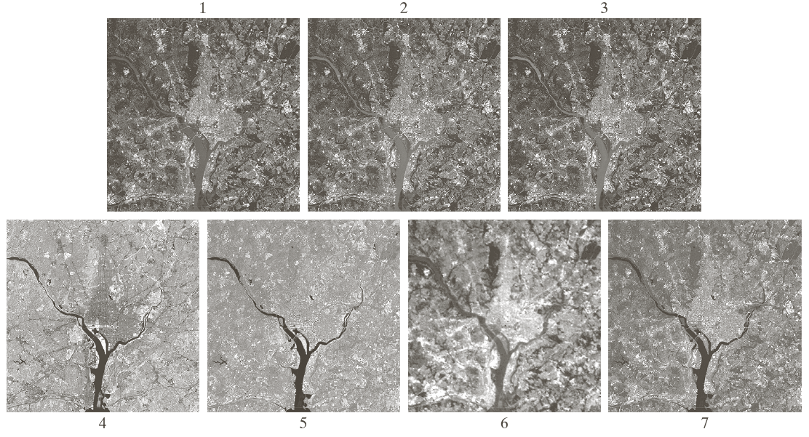
Satellite VIR (Visible – Infrared) Imaging
Source: Gonzalez and Woods

Slide 11
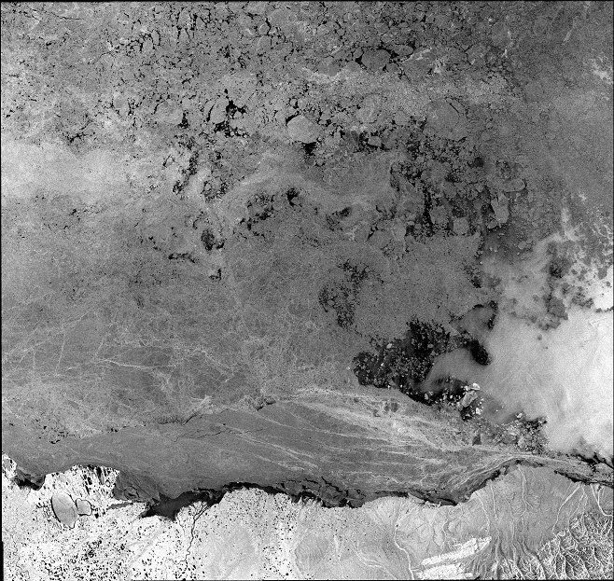
Satellite Radar Image of Sea Ice
Source: MDA

Slide 12
X-Ray Imaging
Source: Gonzalez and Woods

Slide 13
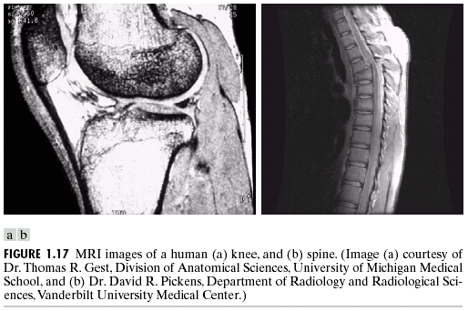
MRI Images
Source: Gonzalez and Woods

Slide 14
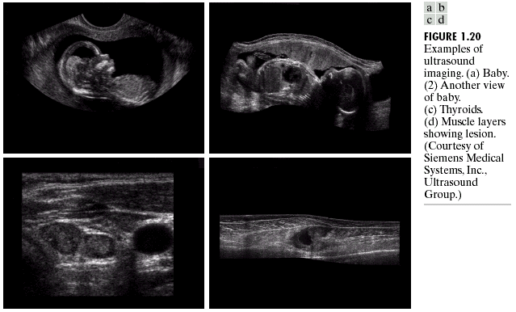
Ultrasound Imaging
Source: Gonzalez and Woods

Slide 15

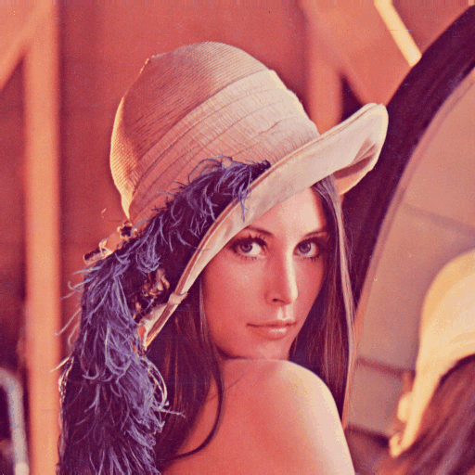
Grey Scale vs Color
Grey scale: single band
Color: three images (red, green, blue) combined to create single image
Notes:
Lena (Swedish) and Lenna (from Playboy to encourage correct pronunciation)

Slide 16
Image Sensing
Source: Gonzalez and Woods

Slide 17
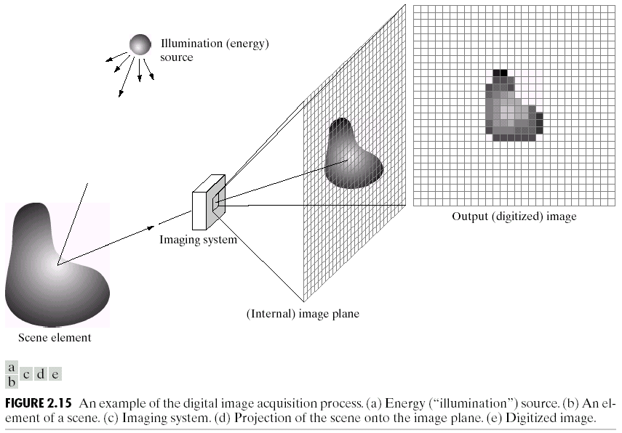
Digital Image Acquisition Example
Source: Gonzalez and Woods

Slide 18
Simple Image Formation Model
Image may be characterized by:
  Amount of source illumination incident on scene
  Amount of illumination reflected by objects in scene (r=0 for total absorption, and r=1 for total reflectance)

Slide 19
Digital Image Representation
Source: Gonzalez and Woods
Notes:
Fig 2.18

Slide 20
Image Sampling and Quantization
Source: Gonzalez and Woods
Notes:
Fig 2.16

Slide 21
Example
Source: Gonzalez and Woods

Slide 22
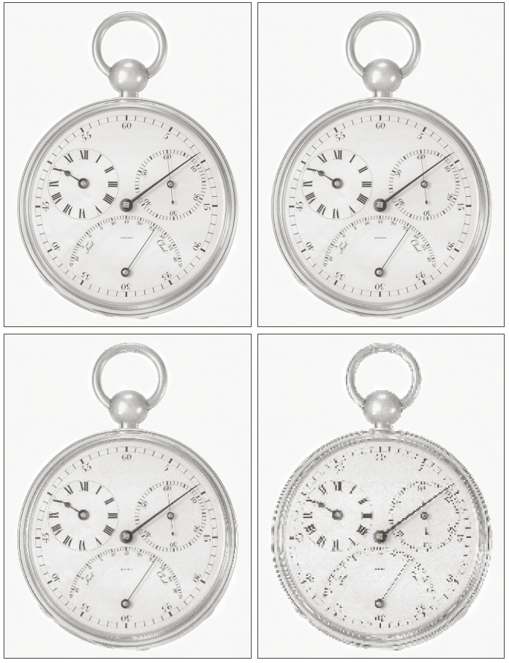
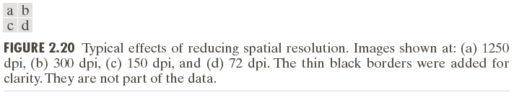
Spatial Resolution
Source: Gonzalez and Woods

Slide 23
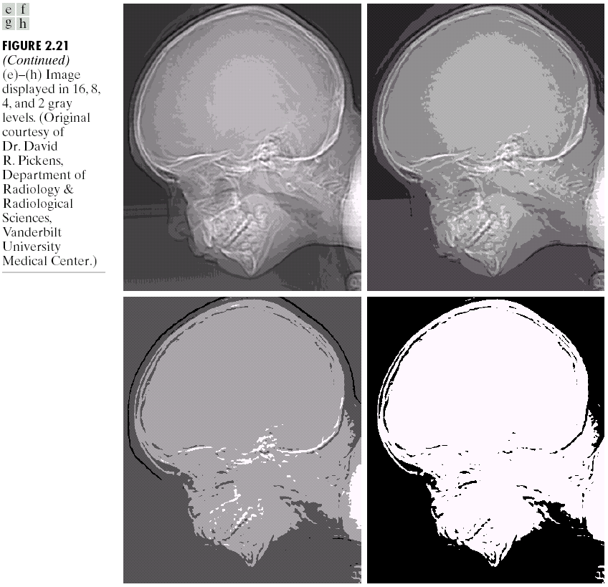
Gray-level Resolution
Source: Gonzalez and Woods

Slide 24
Fundamental Steps
Source: Gonzalez and Woods

Slide 25
Vision and Image Processing (VIP) Lab
UW Research Lab that conducts research in computer vision
Covers many applications: remote sensing, biomedical, video analytics, 3d reconstruction, etc.
Many connections to industry to conduct applied research
Directors: Profs. Clausi, Wong, and Fieguth
http://vip.uwaterloo.ca

Slide 26
Graduate Studies
If you are interested in graduate studies, chat with faculty members in your field of interest
Make sure that you apply for scholarships
  NSERC/OGS applications due typically in October
We are always looking for a few new graduate students to conduct research in the VIP lab (start Spring or Fall terms)

