Slide 1
SYDE 575: Image Processing
Human Vision System
Textbook 2.1

Slide 2
Human Eye
Source: Gonzalez and Woods
Notes:
Cornea: transparent layer forming the front of the eye; covers iris and pupil and is continuous with the sclera; Purposes: shields eye from dust/germs/UV and controls/focuses incoming light (responsible for ~70% of eye’s total focusing power) along with the lens. Note: impact of keratoconus
Lens: changes shape to focus light onto the retina; cataracts are opacities of the lens; presbyopia – age-related loss of accommodation; controls roughly 1/3 of refractive power
Iris: controls diameter of the pupil; defines the ‘eye color’; aperture at the centre is the pupil
Retina: light-sensitive tissue lining the inner surface of the eye; light striking the retina leads to a cascade of electrochemical events that lead to activation of various centres of the brain; cells in the retina include ‘rods’ and ‘cones’ (next slide)
Fovea: maximum acuity of vision, highest density of cones (virtually no rods)

Slide 3
Rods and Cones
Rods
  75 to 150 million
  Sensitive to low levels of illumination
  Dim-light vision (scotopic)
  Monochrome vision
  Low visual resolution (shares nerve ends)
Cones
  6 to 7 million
  Sensitive to high levels of illumination
  Bright-light / day-time vision (photopic)
  High visual resolution (has own nerve end)
  Color vision
Notes:
Rhodopsin found on rods and allows rods to be sensitive to low light conditions; with bright light, the rhodopsin breaks down but then is reconstituted with darkness; lack of rhodopsin (based on Vitamin A) leads to night blindness

Slide 4
Distribution of Rods and Cones
Source: Gonzalez and Woods

Slide 5
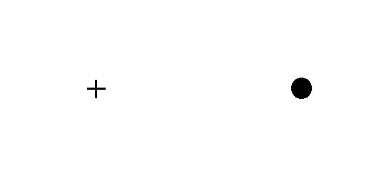
Blind Spot
Close left eye and stare at cross with right eye
Move farther and closer from screen until dot disappears

Slide 6
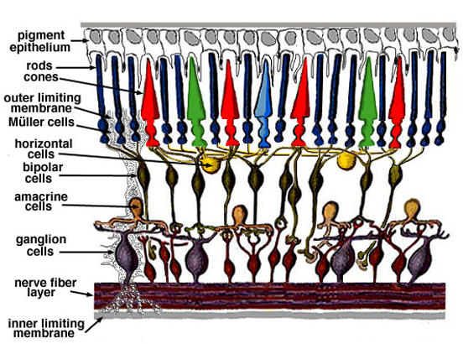
Retinal Layer
http://theness.com/neurologicablog/index.php/the-not-so-intelligent-design-of-the-human-eye/
Notes:
“This processing does not start in the brain, but instead starts immediately in the retina itself. In fact, anatomists regard the retina as a part of the brain that is located outside it, somewhat the way you may regard your home satellite dish as an integral part of your television receiver.”
http://thebrain.mcgill.ca/flash/d/d_02/d_02_cl/d_02_cl_vis/d_02_cl_vis.html

Slide 7
Eye Optics
Source: Gonzalez and Woods

Slide 8
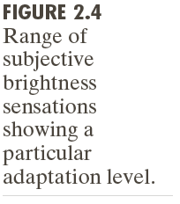
Brightness Adaptation
Notes:
Brightness: intensity of light
Adaptation: changing wrt environmental input i.e., ‘get used to’
So, basically “changes in brightness due to surrounding inputs”.
Not instantaneous e.g., going from dark indoors to bright outdoors
HVS can not operate over this range simultaneously, so must change its overall sensitivity through brightness adaptation
Units are mL: milliLambert, which measures luminance, a photometric measure of the luminous intensity per unit area of light travelling in a given direction. It describes the amount of light that passes through or is emitted from a particular area, and falls within a given solid angle. The SI unit for luminance is candela per square metre (cd/m²). A non-SI term for the same unit is the "nit". The CGS unit of luminance is the stilb, which is equal to one candela per square centimetre or 10 kcd/m².
Ba is an arbitrary brightness level, which implies that anything below its associated lower level, Bb, would just appear black; upper part of the curve not necessarily limited, but increasing the mL would only shift the Ba up and, in turn, shift the Bb up
scotopic vision: vision under low light conditions
Subjective brightness: that perceived by the human, is a logarithmic function of the light intensity on the eye
- Log(100) = log(10^2) = 2 (where log is base 10)

Slide 9
Brightness Discrimination
Source: Gonzalez and Woods
Notes:
What must del_I be set to in order for the circle to be perceived by a human observer?
Ratio del_I/I is the Weber ratio (where del_I is the illumination increment discriminable 50% of the time given a certain I)
Small ratio, good discrimination; large ratio, poor discrimination.

Slide 10
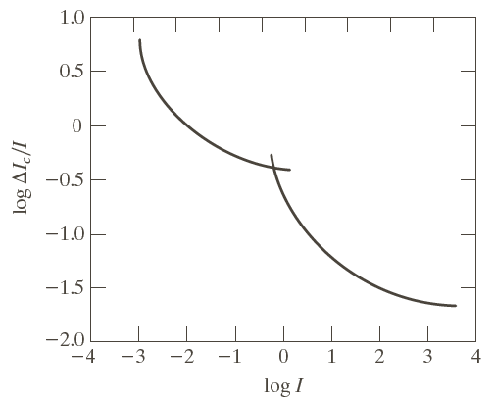
Weber Ratio
Source: Gonzalez and Woods
Notes:
Graph shows that brightness discrimination is poor (large Weber ratio) for low levels of illumination and improves significantly (smaller Weber ratio) at high levels of illumination.
Two branches show a distinction between rods (low illumination) and cones (high illumination).
Note that as someone perceives a scene, the background illumination changes, so that the sensitivity to light sources changes as well

Slide 11
What does it mean?
Brightness discrimination poor (large Weber ratio) at low levels of illumination
Brightness discrimination improves (small Weber ratio) at high levels of illumination
Reflects fact that dim-light vision carried out by rods, while bright-light vision carried out by cones.
Notes:
Radiance is the physical quantity related to light intensity: the power of the light, spreading out in some solid angle, over some area. Luminance is a photometric quantity which is basically the effect of radiance on our eyes. Its a single scalar: the integration of radiance, weighted with this curve, which describes how efficiently different wavelengths of light can trigger the cone receptors in our eyes. Because luminance is a weighted integral of radiance, there is a nice linear relationship between the two.
Brightness, on the other hand, is the subjective visual experience of luminance. Roughly, it is the effect of luminance on the brain. Because its a subjective quantity, the relationship to luminance is non-linear, approximately a cube root.

Slide 12
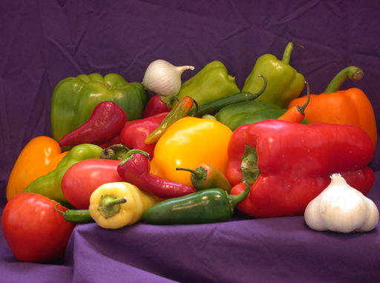

Color vs. Luminance Sensitivity
Human vision system is less sensitive to changes in chrominance (color) than luminance
¼ color information

Slide 13
Mach Band
Source: Gonzalez and Woods
Notes:
Clear demonstration that perceived intensity is not a simple function of intensity. Note that the HVS tends to undershoot or overshoot around the boundary of regions of different intensities. Note here that Mach band effect where the perceived intensity varies at the boundary even though each band is a constant intensity.
Named after Ernst Mach who first described this phenomena in 1865.

Slide 14
Lateral Inhibition
Receptive field of retina organized for contrast detection (discontinuities in distribution of light)
Centre (lateral excitation) and surround regions (lateral inhibition) respond oppositely to light
Neuron activity

Slide 15
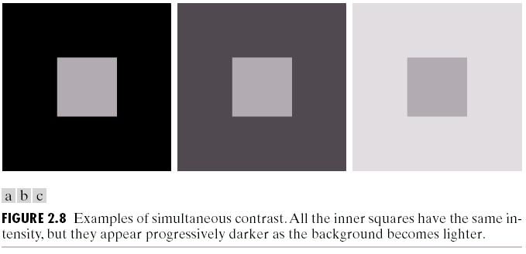
Simultaneous Contrast – Ex. 1
Source: Gonzalez and Woods
Notes:
- region’s perceived brightness does not depend simply on its intensity

Slide 16

Simultaneous Contrast Ex. 2

Slide 17

Simultaneous Contrast Ex. 2
Source: Wikipedia
Notes:
Background varies from dark on lhs to bright on rhs. Middle bar is constant grey but is perceived as going from bright to dark.

Slide 18
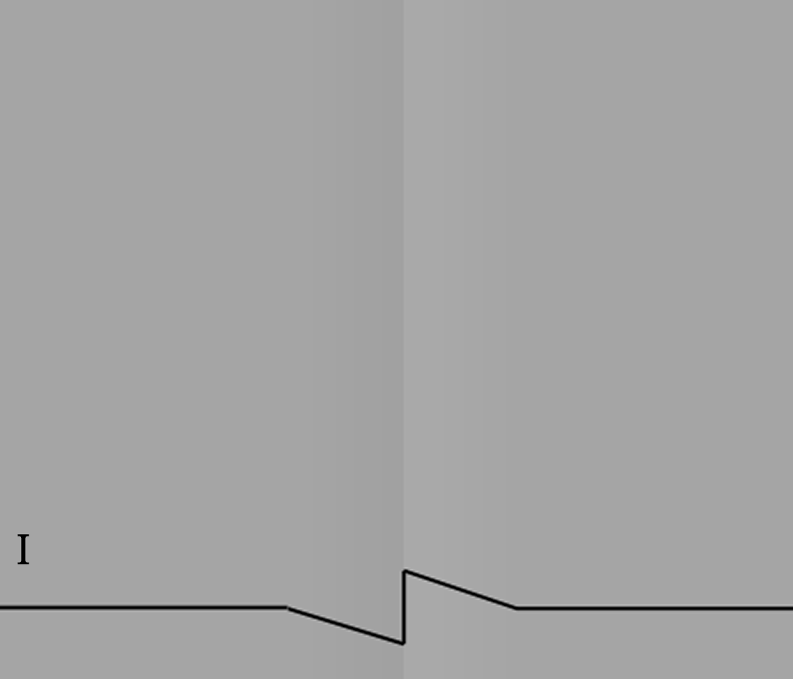
Cornsweet Effect – Perception of Large Areas
Notes:
This phenomenon is similar to the phenomenon of simultaneous contrast and Mach bands, but differs from it in two important respects.
1) In Mach bands, the effect is seen only on areas that are close to the intensity gradient. In the Craik–O'Brien–Cornsweet illusion, a very small area (the central "edge") affects the perception of entire large areas, portions of which are distant from the edge.
2) In the Cornsweet illusion, the region adjacent to the light part of the edge appears lighter, and the region adjacent to the dark part of the edge appears darker, just the opposite of the usual contrast effects.

Slide 19
Cornsweet Effect

Slide 20
Spatial Contrast Sensitivity
Size of retina’s receptive field controls spatial frequency sensitivity
Small receptive fields
  Sensitive to high spatial frequencies
  Responsible for fine detail
Large receptive fields
  Sensitive to low spatial frequencies
  Responsible for coarse detail

Slide 21



Sine Wave Grating
8 cycles/deg
32 cycles/deg
64 cycles/deg
Source: Schieber, 1992

Slide 22
Spatial Contrast Sensitivity
Lateral inhibition results in bandpass nature of spatial contrast sensitivity of human vision system
For coarse gratings (low frequencies), bands fall on both centre and surround region
This results in lateral inhibition and low frequency drop-off in contrast sensitivity
High resolution drop-off due to optical limitations (e.g., packing density of photoreceptor cells)

Slide 23
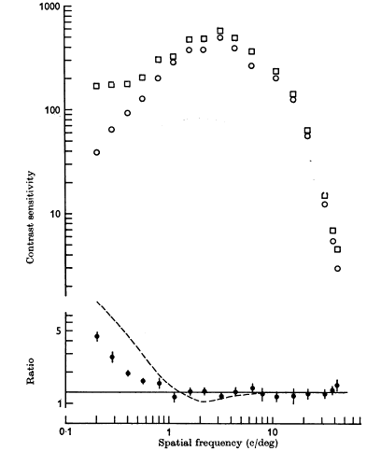
Contrast Sensitivity Function
Source: Campbell et al., 1968

Slide 24
Effects of Spatial Contrast Sensitivity
Human vision good at spotting small brightness differences in low to medium frequencies
Human vision poor at judging brightness differences in regions with high frequency information
Human vision more sensitive to noise in low to medium frequency regions than high frequency regions
Source: Schieber, 1992

Slide 25
Primary Visual Cortex (V1)
Earliest and largest cortical visual area
Majority of all visual information enter cortex through V1
V1 neurons considered simplest of all neurons in visual cortext
Early V1 neurons tuned to low-level visual characteristics such as orientations and spatial frequencies
Often modeled using Gabor functions

Slide 26
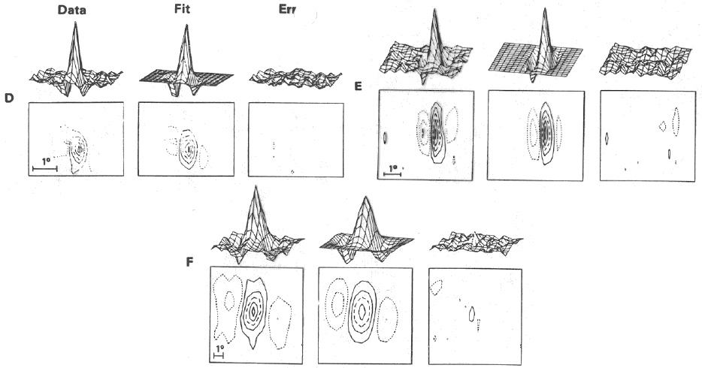
Response of V1 neurons
Source: Jones et al., 1987

Slide 27
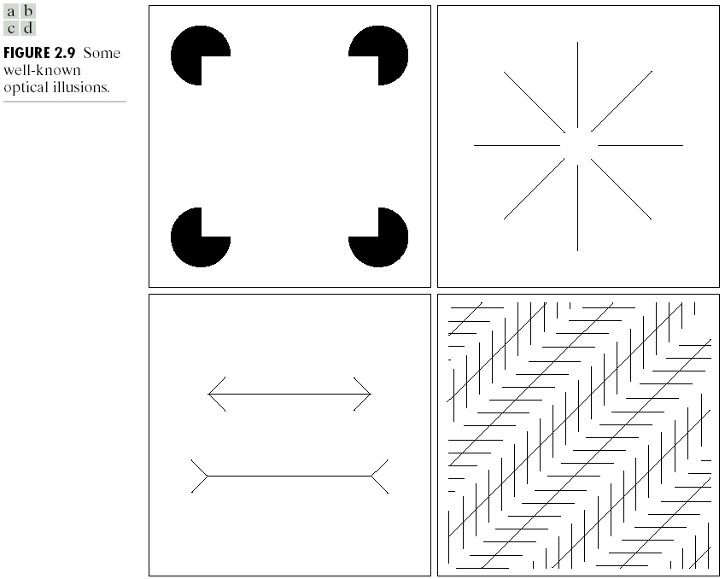
Optical Illusions
Notes:
These are not well explained by biological theory.

Slide 28
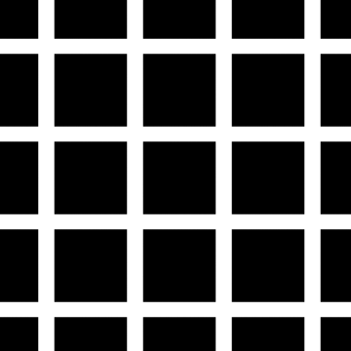
Optical Illusion – Hermann Grid
Notes:
Ghost dots appear at intersections, but disappear when you focus on a particular intersection.
Receptive field contributes to the response of the HVS at a particular point

Slide 29
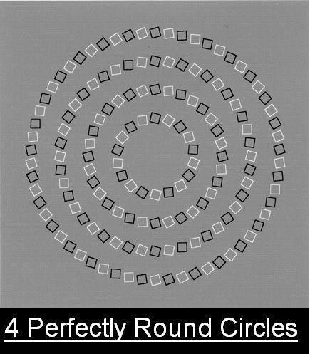
My favourite optical illusion!
Take a quick look - what do you see naturally?
Now look more closely – what do you now see?

Slide 30
Wow!
HVS picks up on the edges of the boxes
Since these edges are angled, the brain assumes continuity, giving the illusion of the boxes forming a spiral shape
Even when you know the answer, it is still difficult to “see” the circles – one has to look carefully

Slide 31
Why care about all of this?
Image quality is highly subjective and greatly dependent on the way our vision system works
By taking into account the pyschovisual characteristics of the human vision systems, we can:
  Design image processing algorithms that make images looks better perceptually
  Design image compression algorithms that look almost as good as the original while storing much less information
  Design information extraction algorithms that provides good representation of the image content

Slide 32
Human Vision vs Computer Vision (based on R. Fisher)
Human:
  Easily processes 3d and video
  Excellent visual interpretation
  Success under range of lighting conditions
  Not well understood
Computer:
  Difficult to get 3d information
  Noise (due to sensor and environment)
  Static viewpoints
  Low spatial resolution
  Well understood algorithms, but these are limited

