Slide 1
SYDE 575: Digital Image Processing
Lecture 2.1 Point Operations
Resampling/Zooming (Text 2.4.4)
Image Quality Metrics (Text p. 354)
Point Noise Models (Text 5.2)
Blackboard Notes

Slide 2
Labs
Labs #1-#5 are each two week labs
Due the Friday after the second lab session
Sometimes, need both lab sessions based on lecture
  Try to keep lectures close to lab sessions so labs reinforce lectures
If you can’t make a due date for a lab, please contact the TAs
  Keep in mind that TAs are also students and they have their own deadlines to take care of

Slide 3
Image Zooming/Resampling
Resampling is used when resizing an image
Resizing involves changing the number of pixels by increasing/decreasing the number of rows/columns, usually by the same %
See blackboard
Notes:
Add details from pp. 65-66 text

Slide 4
Digital Zooming
Nearest neighbor interpolation
  Look for closest pixel in original image
  Fast but causes undesirable checkerboard effect
Bilinear interpolation
  Determines pixel value based on four nearest neighbors
    Perform linear interpolation in x direction
    Perform linear interpolation in y direction based on results of interpolation from x direction
  Does not suffer from checkerboard effect but can result in a blurred appearance

Slide 5
Digital Zooming (cont.)
Bicubic Interpolation
  Determines pixel value based on sixteen nearest neighbors (4x4)
    Perform cubic spline interpolation in x direction
    Perform cubic spline interpolation in y direction based on results of interpolation from x direction
  Does not suffer from checkerboard effect like nearest neighbor interpolation and preserves fine details better than bilinear interpolation

Slide 6
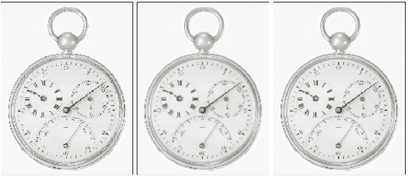
Zooming Results
Nearest Neighbor
Bilinear Interpolation
Bicubic Interpolation
Source: Gonzalez and Woods

Slide 7
Image Quality Measures (p. 354)
Notes:
Discuss whether or not these definitively relate to perceived image quality. MAX is the maximum possible value in the image i.e., 255 for 8-bit data. Will implement these in Lab #1.

Slide 8
Point Noise Degradation
Simple image noise degradation models
Additive noise model
output
input
noise
Multiplicative noise model
output
input
noise

Slide 9
Noise Models
Principal sources of digital image noise arise during image acquisition and/or transmission
  Thermal noise
  Shot noise
  Corruption during transmission over network
In simple noise models, noise is assumed to be independent and white
See Section 5.2 of Gonzalez and Woods
Notes:
Noise is assumed to be independent of itself as well as the signal
“white” refers

Slide 10
Some Point Noise Models
Source: Gonzalez and Woods
Notes:
What does the histogram of the original image look like?

Slide 11
Some Noise Models
Source: Gonzalez and Woods

