Slide 1
SYDE 575: Digital Image Processing
Point Operations - Histograms
Textbook 3.1-3.3 - Histograms
Blackboard Notes

Slide 2
Enhancement vs. Restoration
Enhancement: qualitative approach to improving the perceived appearance of an image
Restoration: model-based approach to improve the statistics of an image and, hopefully, improve perceived appearance
Point processing involves enhancement

Slide 3
Point Processing
Simplest of image enhancement techniques
Processing based only on intensity of individual pixels
Given g(x,y) as the output pixel, f(x,y) as the input pixel, and T as some transformation
g(x,y) = T[f(x,y)]

Slide 4
Histograms
Histogram
  n_{k} represents the number of occurrences for the k^{th} gray level z_{k}
Normalized Histogram
  Probability of occurrence of gray level z_{k} (probability distribution function or pdf) by normalizing the occurrence of each grey level by the total number of pixels (N)
  L is the total number of grey levels
See blackboard sketches

Slide 5
Continuous Representation
For a continuous distribution bounded between 0 and L-1:
∫ p(r) dr = 1
What term is used for the integral of a pdf?
Recall:
μ = Mean = ∫ r p(r) dr
σ² = Variance = ∫ (r - μ)² p(r) dr
Notes:
cdf: cumulative distribution function
Next year: add discrete mean and variance

Slide 6
Contrast
What is meant by contrast?
  Distribution of grey levels in an image
  Represented by the histogram
  Types of contrast:
Low
High
Best??
Notes:
Sketch in continuous – just easier that way!

Slide 7
Levels of Contrast
Source: Gonzalez and Woods

Slide 8
Histograms: Example
Source: Gonzalez and Woods

Slide 9
Conditions
Transformation should be monotonically increasing or monotonically decreasing
  Ensures no artifacts based on reversals of intensity
Range of output should be the same as range of input.
Notes:
After this slide, use handwritten notes covering linear, quadratic, and square root transformations

Slide 10
Point Transformations
See blackboard:
  Linear, quadratic, square root transformations

Slide 11
Intensity Transformation Function
Source: Gonzalez and Woods

Slide 12
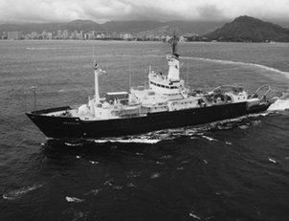
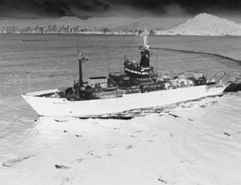
Example: Negative

Slide 13
Gamma Correction
Various devices used for image acquisition and display respond based on power law
Process used to correct power law response phenomena is called gamma correction
s = r ^{γ}

Slide 14
Gamma Curves
Source: Gonzalez and Woods

Slide 15
Gamma Correction: Example
Source: Gonzalez and Woods

Slide 16
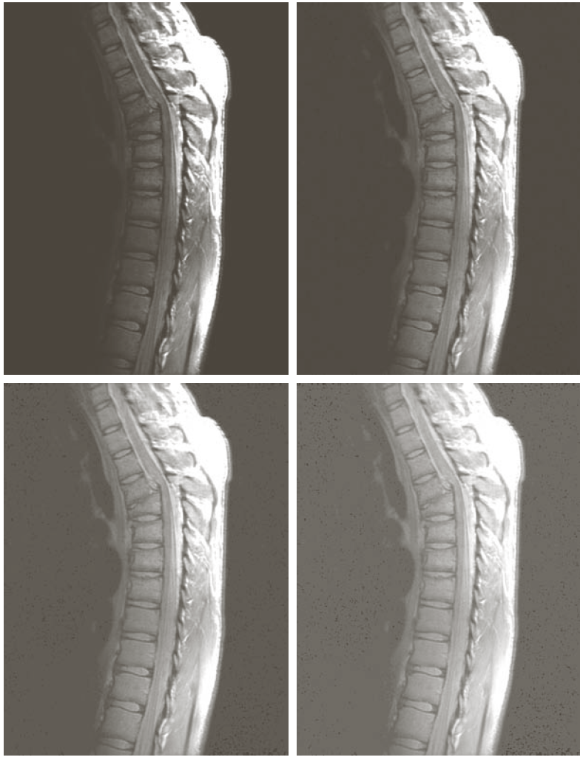
Gamma Transformation: stretch low range and compress high range
Source: Gonzalez and Woods
Notes:
Compress high ranges, stretch low ranges

Slide 17
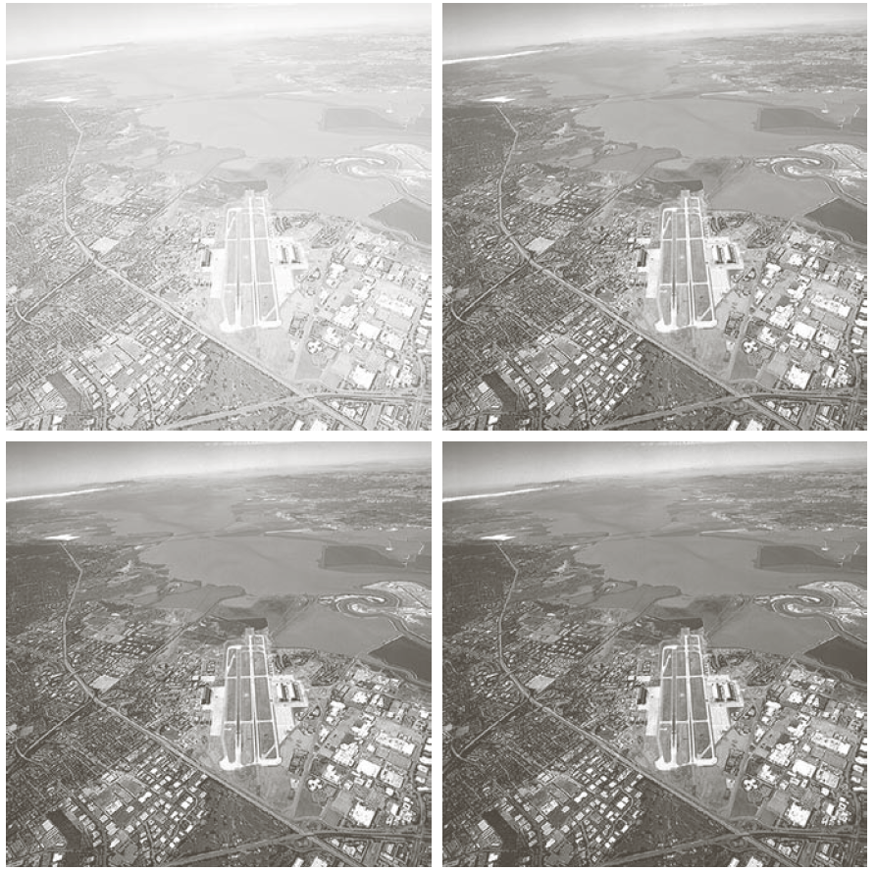
Gamma Transformation: compress low range and stretch high range
Source: Gonzalez and Woods
Notes:
Compress low ranges and stretch high ranges

Slide 18
Other Point Transformations
Can also use an exponential transformation
s = exp(βr) -1
Or a log (base e) transformation
s = α ln (r+1)
How will you set β and α in order to have the input range = output range?
Notes:
Beta = ln(2) and alpha = 1/ln(2) for range [0,1]
And Beta = ln(L)/(L-1) and alpha = (L-1)/ln(L) for range [0,L-1]

Slide 19
Log and Inverse Log Transforms

Slide 20
Enhancing the 2D Fourier Spectrum
Notes:
Take dark regions and stretch so that energy is more visible.

Slide 21
Histogram Equalization
High-contrast images are often desirable from a visual perspective
High-contrast images have histograms where the components cover a wide dynamic range
Distribution of pixels are close to a uniform distribution
Intuitively, low-contrast images can be enhanced by transforming its pixel distribution into a uniform distribution to achieve high contrast

Slide 22
Histogram Equalization
Let p(r) and p(s) denote the probability density functions of r and s
For s=T(r), p(s) can be expressed as:
p(s) ds = p(r) dr
Since we want to transform the input image such that the pixel distribution is uniform,
p(s) = 1/(L-1), 0 ≤ s ≤ L-1
Notes:
See p. 2-4 of handwritten notes

Slide 23
Histogram Equalization
What transformation will give you a uniform distribution for s?
  cumulative distribution function (CDF)
  s = T(r) = (L – 1) ∫ p(x) dx (integrate from 0 to r)
Notes:
Note: assumes integration between 0 and 1.

Slide 24
Histogram Equalization
Source: Gonzalez and Woods

Slide 25
Histogram Equalization
For discrete case, also use the cdf
s_{k} = T(r_{k}) = ( L – 1 ) Σ p(r_{j}) (sum j = 0 to k)

Slide 26
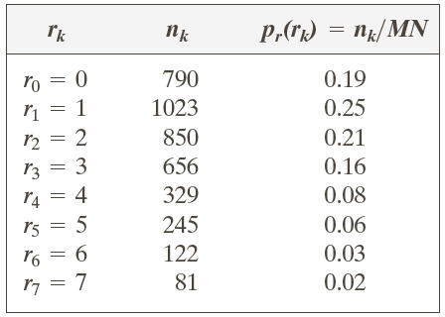
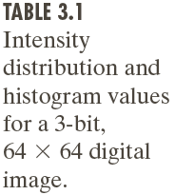
Histogram Equalization: Example
Source: Gonzalez and Woods
Notes:
Cdf: 0.19, 0.44, 0.65, 0.81, 0.89, 0.95, 0.98, 1.00

Slide 27
Histogram Equalization: Example
Source: Gonzalez and Woods

Slide 28
Histogram Equalization: Example
Source: Gonzalez and Woods

Slide 29
Local Histogram Equalization
Global approach good for overall contrast enhancement
However, there may be cases where it is necessary to enhance details over small areas in image
Solution: perform histogram equalization over a small neighborhood

Slide 30
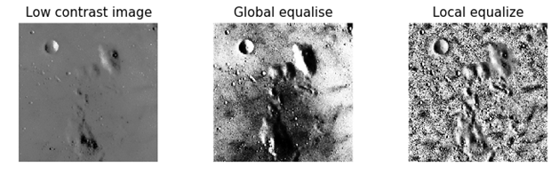
Local Histogram Equalization: Example
http://scikit-image.org/docs/dev/auto_examples/plot_local_equalize.html

