Slide 1
Engineering Accreditation
Engineering Computing

Slide 2
Accreditation Process
Ensure every graduating student has met the required level of Engineering knowledge and experience

Slide 3
Every Course Taken
Determine number of hours of instructor contact defined as class, tutorials, lab time per week, number of weeks
  For every hour, class counts as 1 AU, (Academic Unit) others count as 0.5 AU
Map Individual Learning Attributes (ILO) in each course to 12 categories of Engineering General Attributes
Determine percentage of math, natural science, Engineering science, Engineering design, complementary studies, and other category for each course from ILOs
  Multiply each by the AU for the course to get percent AUs for each category per course
Determine whether course/section is taught by a PEng (100% value), a PEng Applicant (lesser % value), non-PEng (0% value)

Slide 4
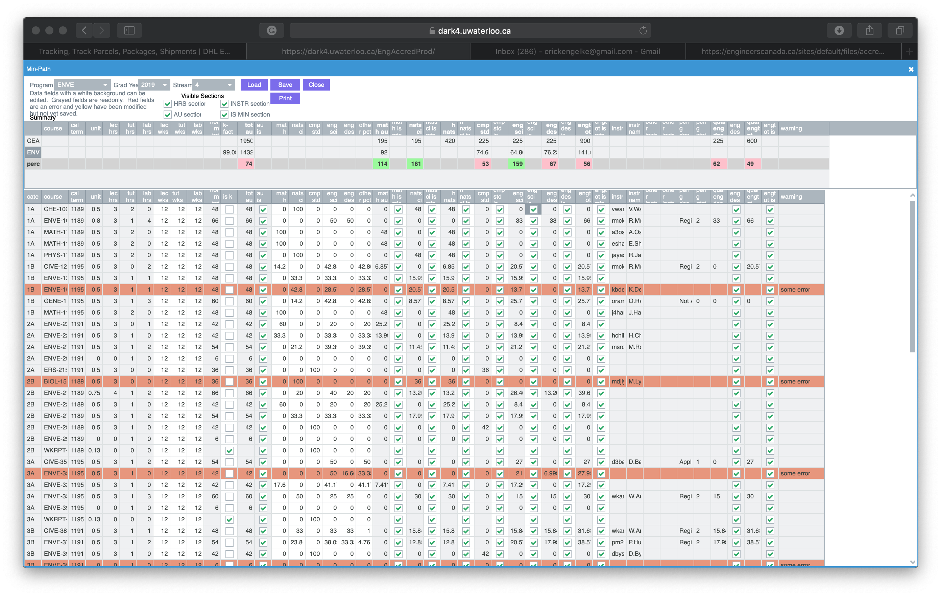

Slide 5
For Other Assignments, Coop, Projects
For studies where the number of hours is not determined or verifiable, we use K to estimate the value of the assignment/coop/project
  K is the average AU per core course
  K is calculated as Sum of AUs / Sum of Course Units
Note: any and every change in the prior section, when applied to core courses, requires K to be recalculated and reapplied to these assignments

Slide 6
Minimum Path
Given all the course information provided under the previous slides, plus all pre-requisites
  Calculate the minimum path for each of the categories
    What would the weakest course path possible mean
  Express the minimum path as a percentage of the mandated values in each study area
Present real-time Summaries of the Minimum Path for individual Programs and Faculty as a Whole

Slide 7
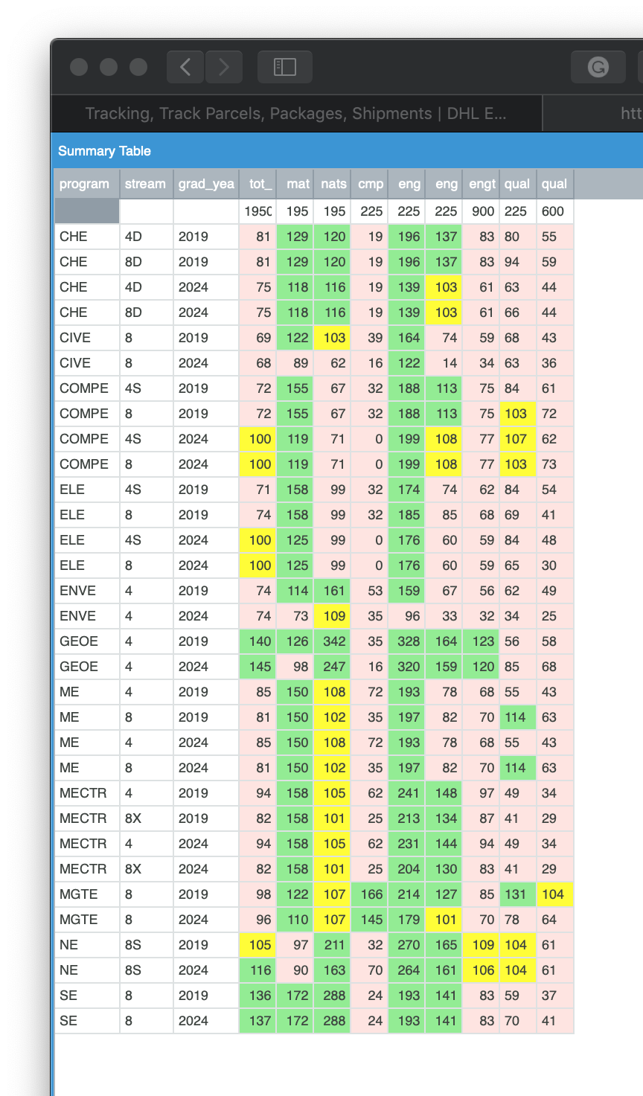

Slide 8
Deeper Analysis
For every course:
  Collect the textbooks and course syllabus
  Present the complete list of assignments, tests and exams for review
    Present anonymized samples of Strong, Average and Weak student submissions for each
  Present the class percentages of each grade type: failures, weak, typical, strong
Thousands of documents, organized by numerous attributes for searching by accreditation team during visit

