Slide 1
Emerge
An Network-based
Emergency Notification System
December 2008
Erick Engelke
University of Waterloo

Slide 2
The Problem
North American rise in threats to campuses
Fire alarms only tell people to leave the building and congregate outside
Need mechanisms (multi-layered) to disseminate real-time information about crises

Slide 3
Possible Messages
Leave buildings and campus
Stay put, it’s safer there
We do not know all possible messages in advance
Possibly different messages for different buildings

Slide 4
Emerge
Can run on Windows, Mac and Linux computers
Works through most firewalls
Maintains connection with a campus server(s) – verify active clients
Displays messages immediately (mere seconds to do whole campus)
Can target messages to specific buildings
Displays web based messages, graphics, hyperlinks, notification sounds
Supports multiple servers (eg. Campus, Faculty)

Slide 5
Audience
First Phase:
  ADS – 1,920 computers
  Nexus – 4,300 computers
  Arts Faculty – 350 computers
Second Phase
  Unmanaged workstations
  Linux/Macs
  Client owned (residence)
  Laptops

Slide 6
Open Standards
HTML
  Multiplatform compatibility
  Inherently support rich media
    Text, sound, colour, pictures, even video
DNS (domain names)
  Campus uses TXT field to specify room locations
  Emerge can use these locations to filter messages

Slide 7
Design
Needs to be highly scalable
  7,000 client in first phase
  Perhaps 15,000 clients in next phase
  Each server can handle many clients
  Design allows chaining of servers if necessary
  Protocol cannot be noisy or server will overload

Slide 8
Protocol
  Push (not a periodic poll like RSS)
  – instant notification
Client connects to server
  Registers itself – ‘online’
    DNS location stored in case needed
  Connection is re-established if it breaks
  Every 20 minutes client tests to verify server up
  If server down, go to failover server
  Includes a NO-OP diagnostic operation

Slide 9
All Versions
URL passed to client in emergency event
Displays web page on desktop
  Linux/FreeBSD – uses FireFox
  Mac – uses user’s favourite browser
  PC – uses special IE based tool
Goes back to listening for more instructions

Slide 10
PC Version
Registers on “system tray”
  Icon visible
  User documentation available with click
Browser is customized
  “stay on top” window
  Updates to latest message, discarding older ones

Slide 11
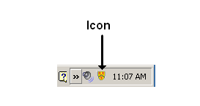
Gentle Reminder on System Tray (Windows Version)

Slide 12
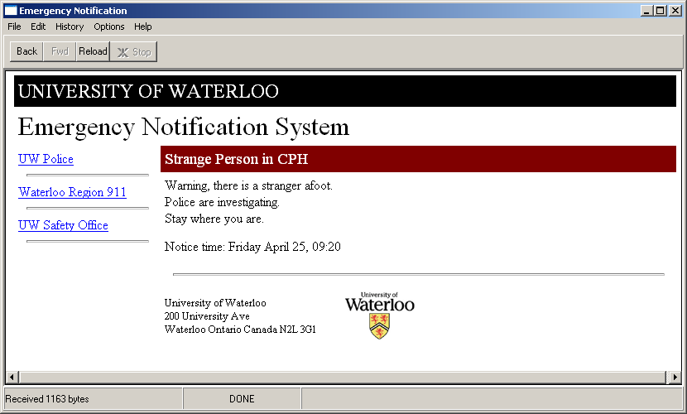
Pop Up Message (Version 1.0)

Slide 13
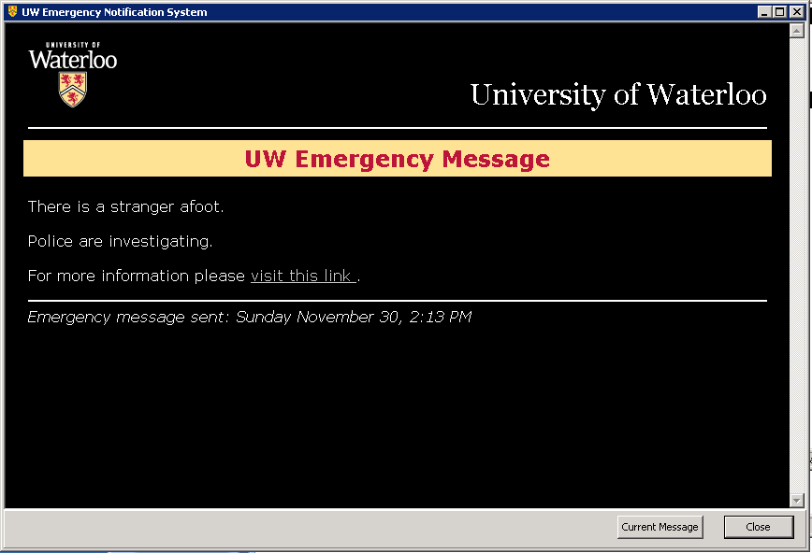
Popup Message (Version 1.1)

Slide 14
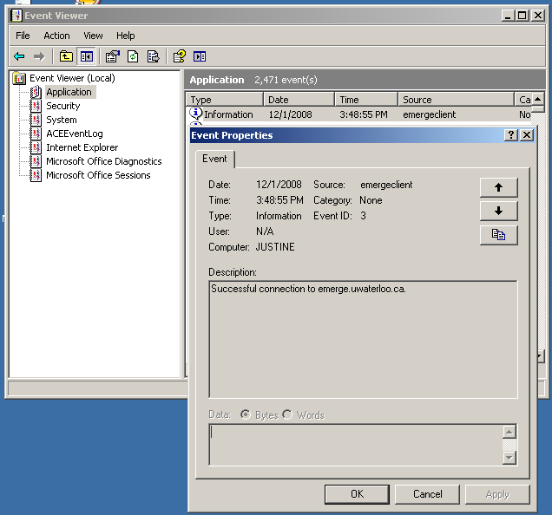
Event Viewer (Windows)

Slide 15
Verifying Emerge Connected
C:\>netstat | grep 3389
File STDIN:
TCP justine:4959 dark.uwaterloo.ca:3389 ESTABLISHED
TCP justine:4960 ist-xas.uwaterloo.ca:3389 ESTABLISHED
Dark is a test server, only used for my PC
Ist-xas is the campus emerge server

Slide 16
Macs and Linux
According to DNS (do you bother…)
perhaps 1,464 Macs on campus
and maybe 1,341 Linux computers

Slide 17
Linux/FreeBSD
Identical codebase Linux and FreeBSD
Small memory image, 25kB
Requires FireFox
Instructions for various window managers (eg. gnome)
Invisible

Slide 18
Mac Version
Almost identical code to FreeBSD/Linux
Runs as a unix process
Includes an AppleScript .app to start at login time
Uses user’s default web browser
Small 24 kB process footprint (until 1st message)
invisible

Slide 19
Programming Observations
Win32 not .NET – want it to run everywhere!
Windows version more complicated, but feature-rich
Windows COM used to control IE
  Used to be called OLE, very integrated
  Complexity hidden by language support (Delphi)
AppleScript used on Mac version
  Controls browser
  Used to glue “Unix” code to GUI startup

Slide 20
How Many Lines of Code
PC – 900 lines
  150 for net code
  50 for supporting multiple emerge domains
  120 for event log
  580 for gui
Mac/FreeBSD/Linux – 250 lines
Java – 125 lines

Slide 21
Permissions
Send Test Messages
  Everyone can send a message to themselves
  Some people can send messages to others
Send Production Messages
  A few select people can send to the campus

Slide 22
Optional Message Composer
Simple to use
Create messages with UW look/feel
Preview before message is sent
Compose/send in any web browser anywhere
  including Blackberry
Includes Date/Time of message

Slide 23
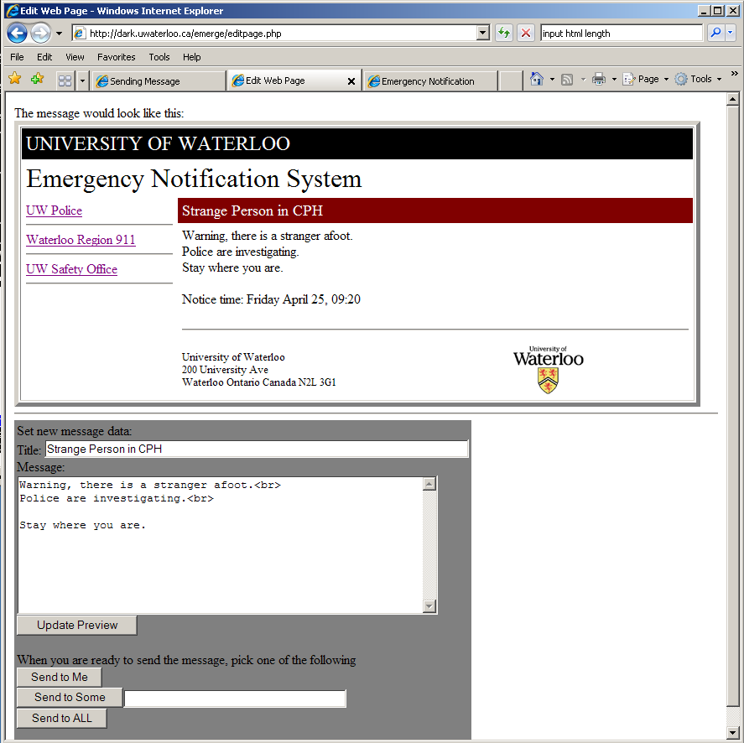
Visual Message Composer

Slide 24
On Portable Code
C
  write once, #ifdef many, rewrite for windows
Java
  write once, run any
Delphi / Lazarus
  write once, compile anywhere (not Blackberry)
  produces a native application

Slide 25
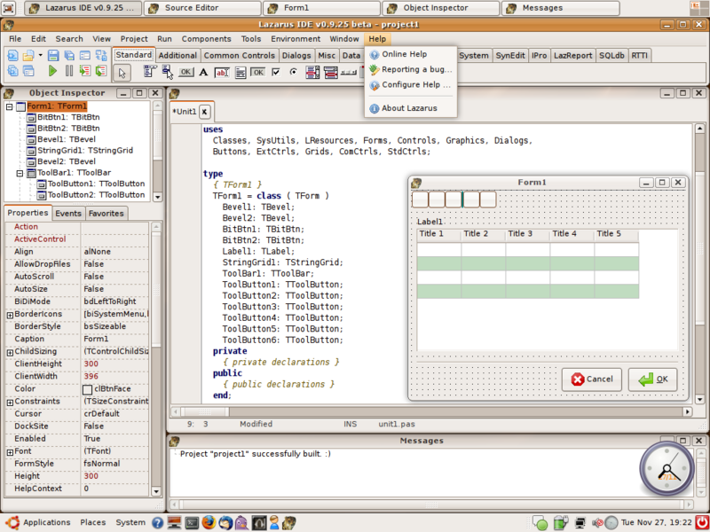
Lazarus on Linux

Slide 26
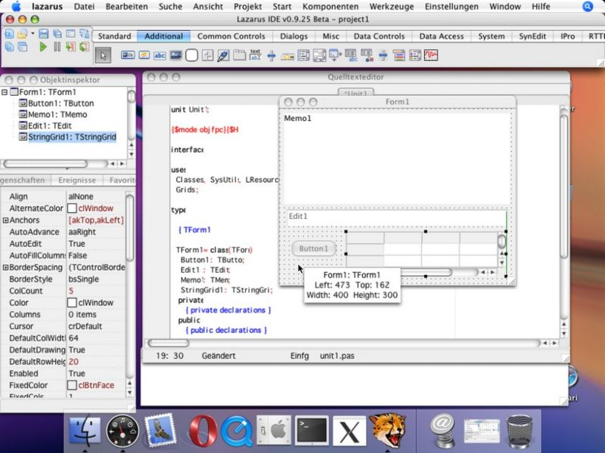
Lazarus on Mac

Slide 27
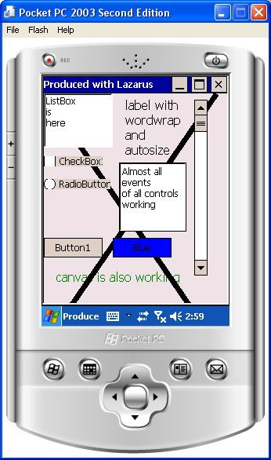
Lazarus on Windows CE

