Slide 1
Tuque for Laptops
March 2024
Erick Engelke
Engineering Computing

Slide 2
Goals for Tuque for Laptops
Easy to install on laptop
Works without requiring Active Directory
Use Tuque packages to install software
Permit use of Tuque groups to manage multiple packages
Use “CopyFrom” to clone a laptop or computer
Have permissions which restrict access to relevant groups
Does not slow down home networks, updates only while at UW

Slide 3
Step 1: Download Tuque service and Signup Utility
Download LATEST files to the local computer https://tuque.uwaterloo.ca
Install and Start Tuque Registration by running the program.
When it first runs, the machine will not be registered yet, that’s the next step

Slide 4
Step 2: TuqueSignup
This utility is executed automatically, it adds a laptop to Tuque independent of its IP or DNS
It saves the name in the computer and in Tuque’s database, and a unique key to guarantee this is the computer
Attempt to add another computer with the same name but different key returns an ERROR
Any time the laptop can connect to Tuque, it will get updates. Except through the VPN or off campus
Tuqueinstaller will default to suggesting the NetBIOS name of the computer, but you can change it to anything you want in the edit box

Slide 5
Register the laptop, eg. maggot100

Slide 6
Register maggot100… after pressing button
That’s all you have to do.

Slide 7
Go to Tuque, list computers

Slide 8
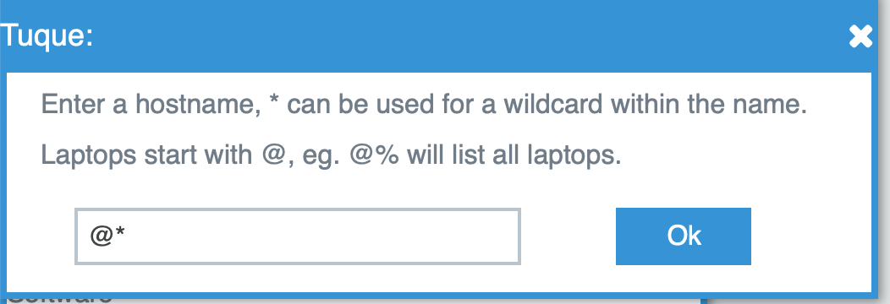
List all laptops, @*

Slide 9
And Tuque finds them, and also indicates who added each and when they last updated

Slide 10
Adding software, eg. Chrome

Slide 11
Some operations
You can add a @laptop to groups, so they can be bulk managed
Eg. I’ve added @maggot100 to englaptops
Last Messages displays current operation
Eg. here the laptop is stuck trying to download Chrome but is failing because VPN didn’t allow it
It will keep trying, defaults to every 10 minutes, very little network overhead by trying that often

Slide 12
logs activity and failures
Log file is: C:\nexus\install.log
Will fail if the network is not local to campus, timeout and retry a few minutes later
every 10 minutes by default, settable
Sample
3/11/2024 8:02:31 PM Found app: Google Chrome 120.0.6099.62
3/11/2024 8:02:31 PM Must create working dir c:\nexus\install\work
3/11/2024 8:02:31 PM downloading Google Chrome 120.0.6099.62
3/11/2024 8:02:52 PM exceptionError sending data: (12002) The operation timed out
3/11/2024 8:12:55 PM downloading Google Chrome 120.0.6099.62
3/11/2024 8:13:16 PM exceptionError sending data: (12002) The operation timed out

Slide 13
Laptop Permissions
Normally Tuque uses the position in AD to determine which group of users has write access, that’s not available on laptops with no AD.
Instead, Tuque grants permissions to all members as the same group as the person who added the laptop.
E.g. Martin adds a laptop to Tuque, so Dave and the rest of EngComp inherit permissions to write to it
Current groups include: AUArch, AUSysD, AUECE, AUEng (EngComp)

