Slide 1
pocketNexus
by Erick Engelke
November 12, 2014
Version 0.904 Shown

Slide 2
Challenge
many people have laptops or home or office computers
they are outside nexus domain
connect using wireless or externally with VPN or campus Ethernet
perhaps 25-30% are Macs
maybe 5-10% are Linux
want to integrate them with campus services

Slide 3
Solutions to date
detailed written instructions with screenshots
tell people to use Outlook (some people prefer other Email programs, or live on Linux without MS-Office)

Slide 4
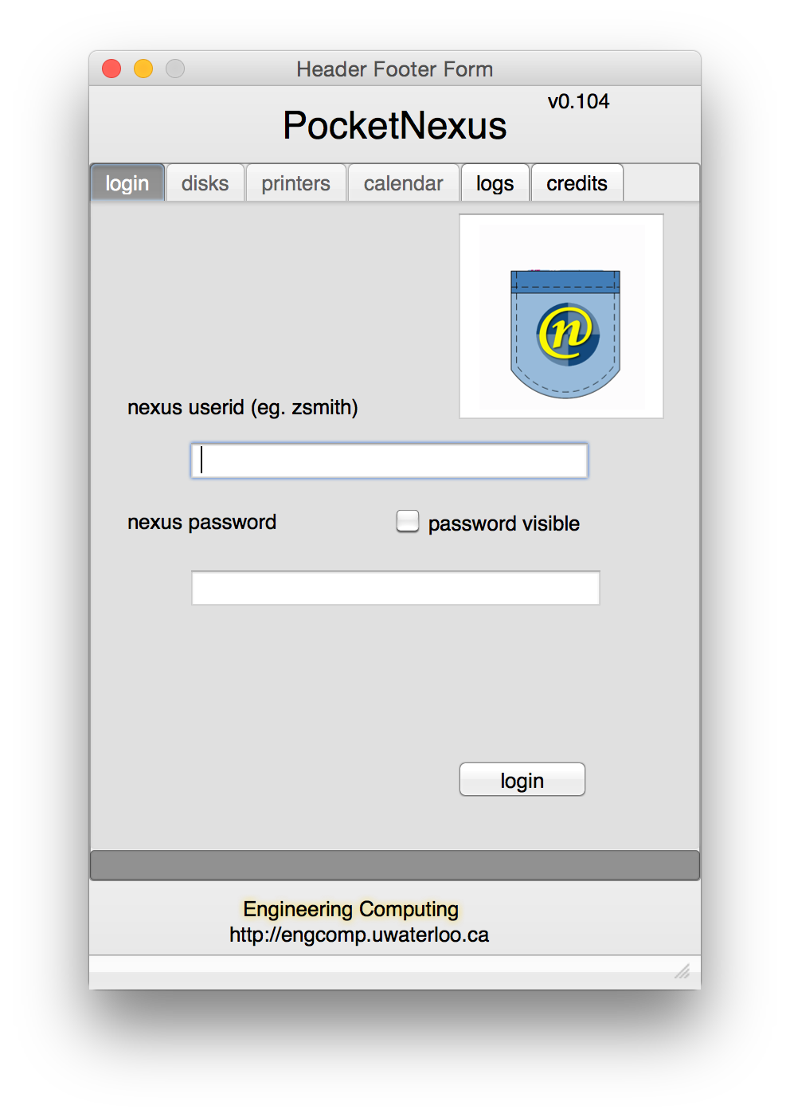
Login
user simply does nexus login
gains access to growing collection of services
as far as user is concerned, it’s all connected
single sign on

Slide 5
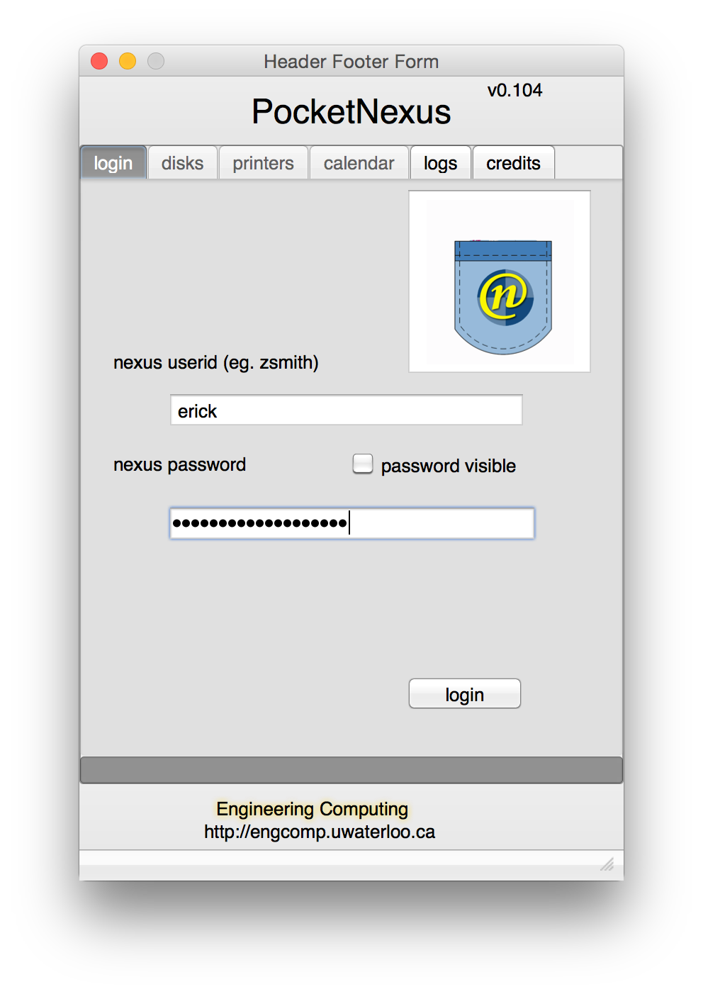
actual login example used for following slides
access services instantly

Slide 6
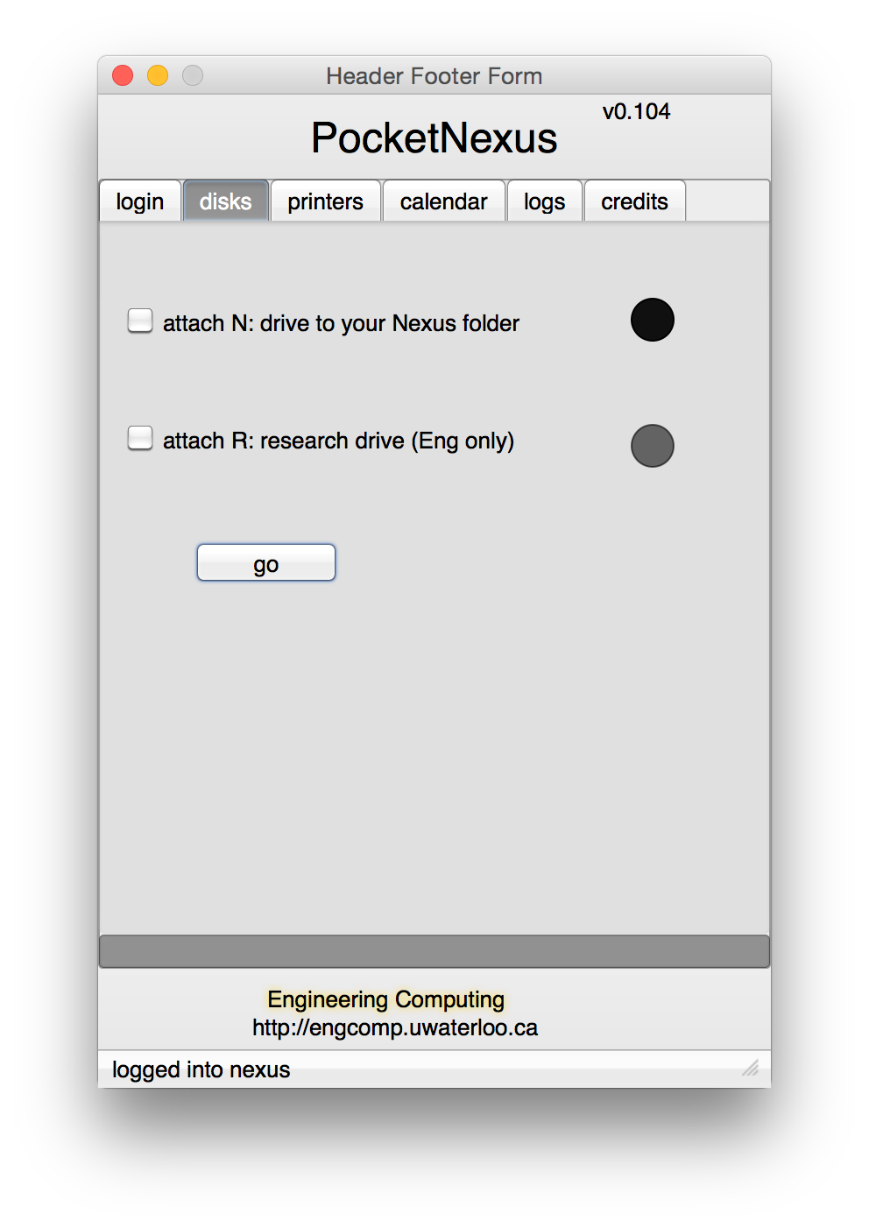
Attach Network Storage
all users have an N: drive
initially shows what is present
dark bulb indicates not present

Slide 7
the user selects drives to attach and presses go
N: drive available for all on nexus
R: is an Engineering research 1 TB drive
If we extend schema, we could have personalized/org-specific drives

Slide 8
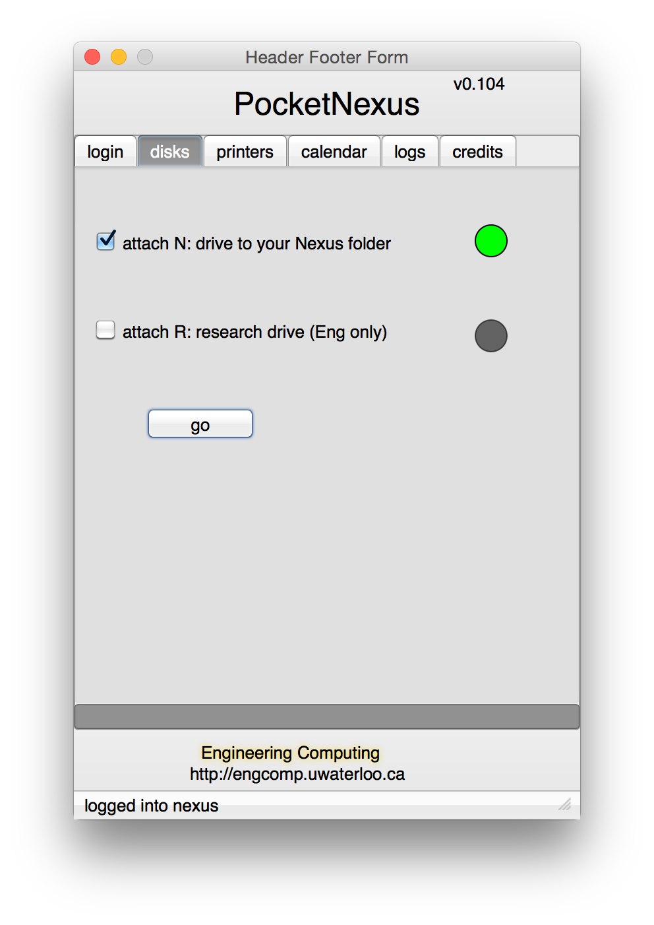
drives which attach are lit green
colourblind people see a lit light versus an off bulb

Slide 9
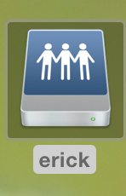
Desktop
on Macs, the attached drive appears as a shared folder on the desktop

Slide 10
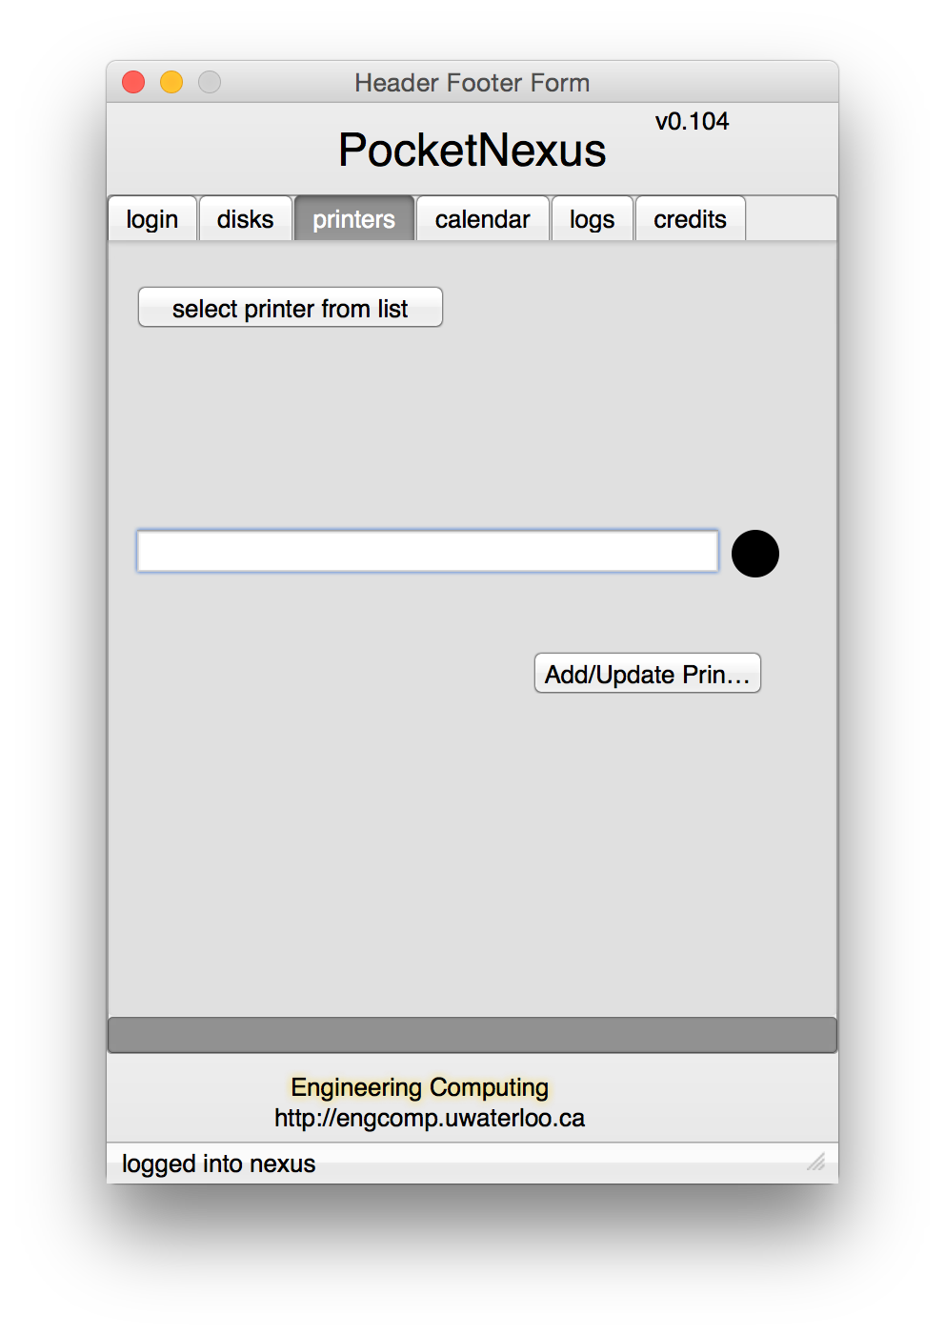
Printing
there are over 800 printer queues on nexus
faculty, staff, grads use departmental printers
grads and undergrads use labs for computing and printing
one system for everyone and everything

Slide 11
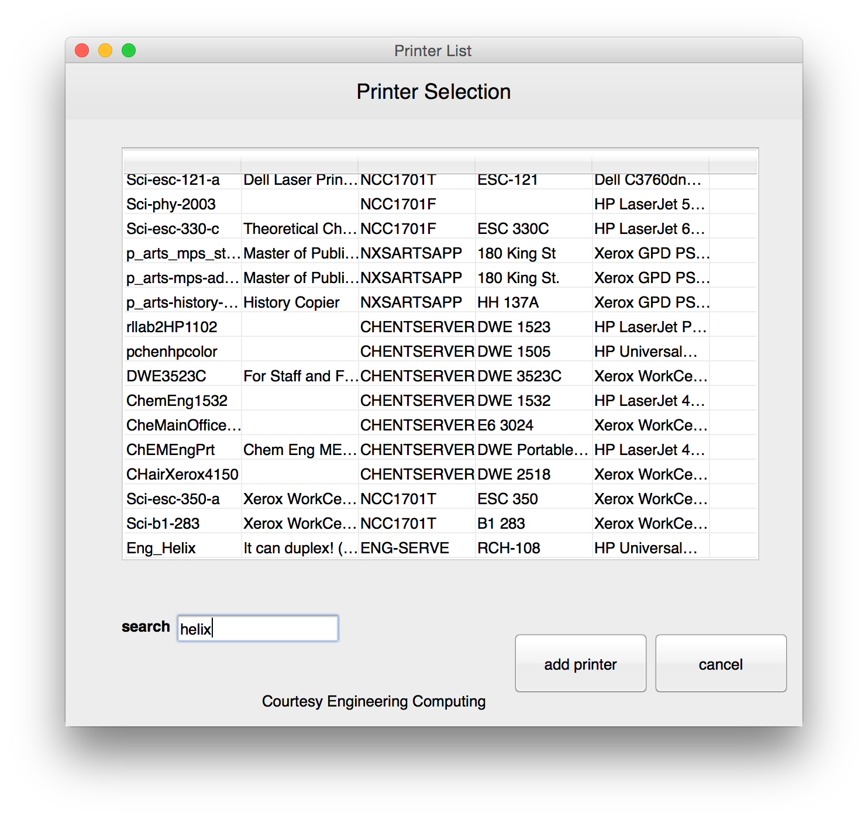
search by queue, room, server, etc.

Slide 12
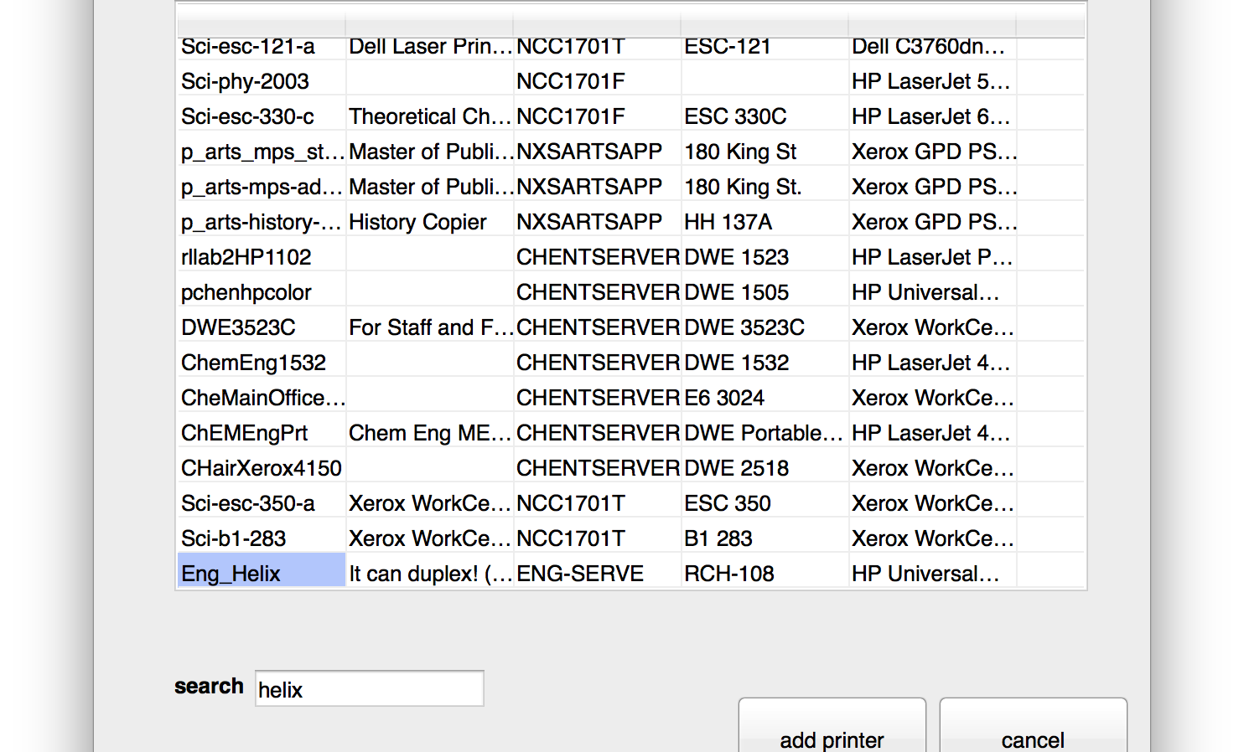
searching for Helix

Slide 13
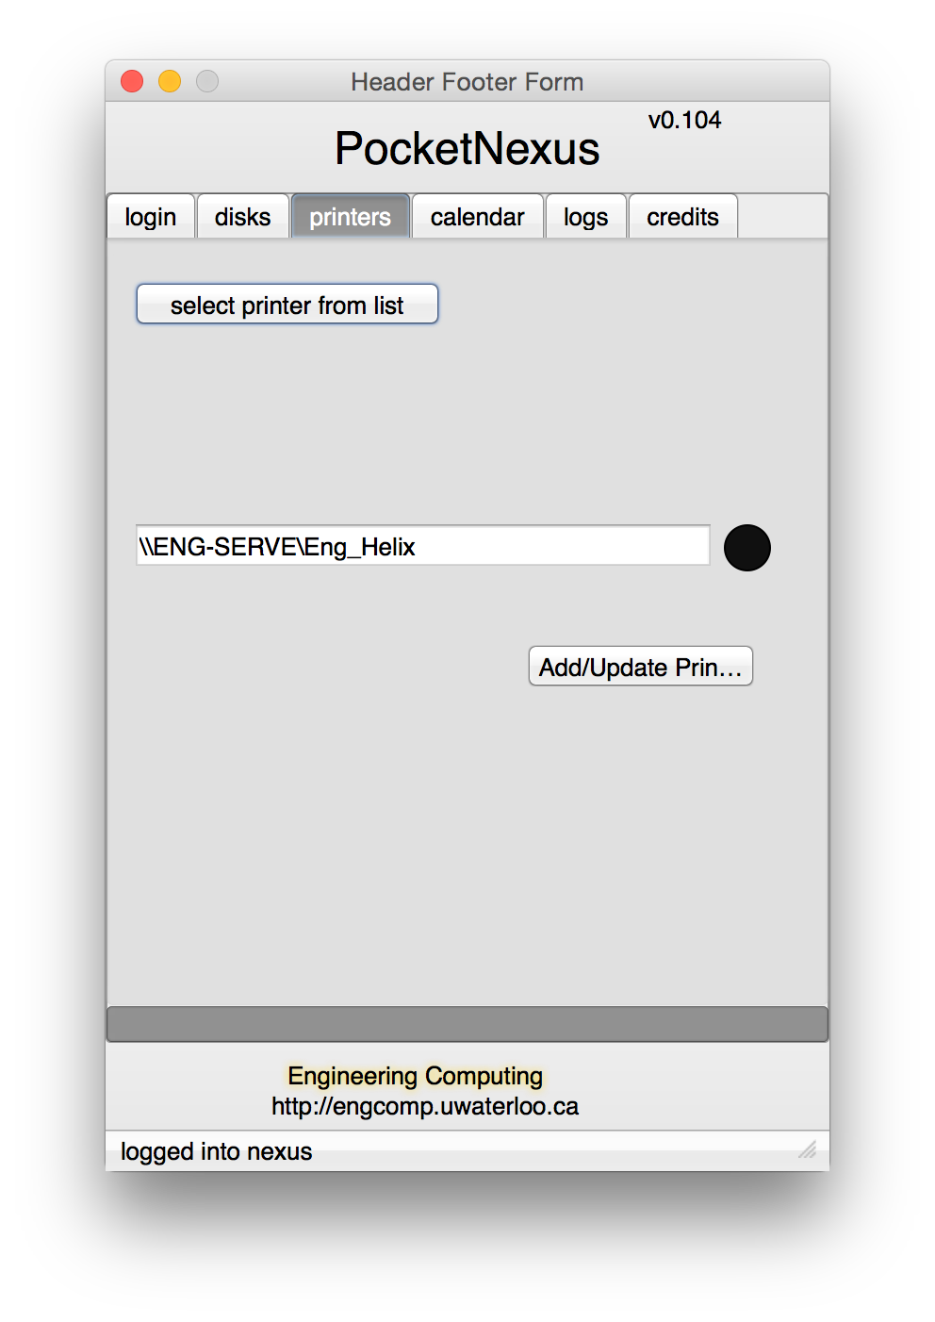
now press Add/Update to add or update the printer

Slide 14
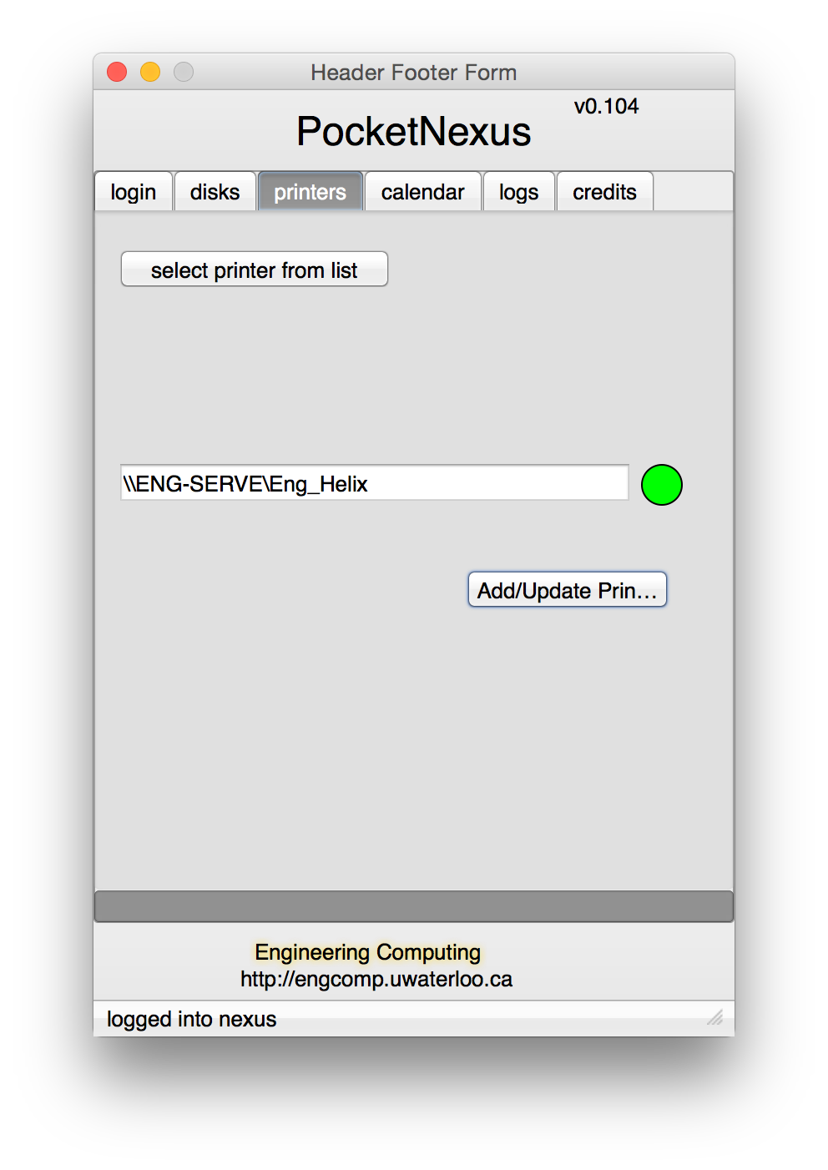
again, green bulb indicates success

Slide 15
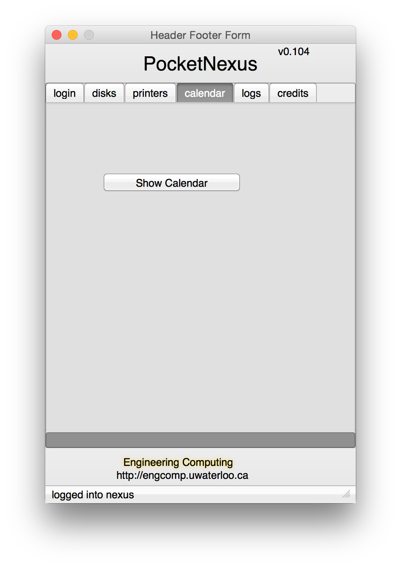
Exchange Calendar
simply click to login to calendar-lite

Slide 16
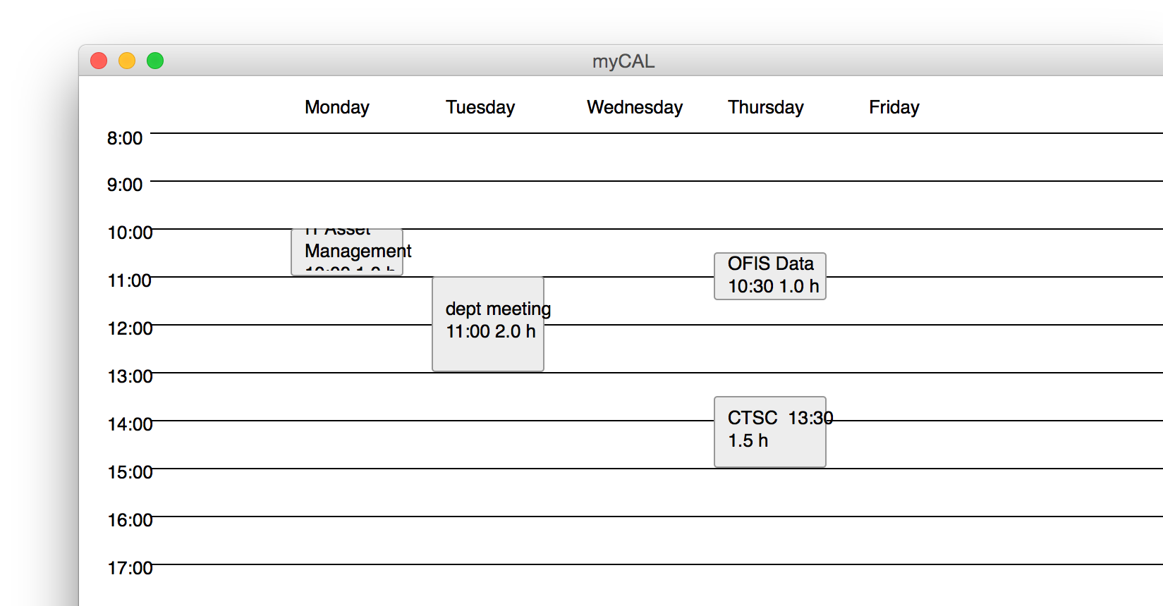
shows the current week’s events

Slide 17
from a colleague:
Any intelligent fool can make things bigger, more complex and more violent. It takes a touch of genius, and a lot of courage to move in the other direction.
ALBERT EINSTEIN

